Slide 2
Program Sponsor

Slide 3
Slides, External resources & registration can be found at www.solonchamber.com/slides
Materials will also be distributed by email after the program!

Slide 4
May 8th
De-Escalation with Patrick Johnson, PRADCO
June 12th
First Aid Basics with Aubi Nemeth, Sixth City CPR

Slide 11
Important Dates – state funded Employers
April
No important dates
May 31
Drug-Free Safety Program (DFSP) application deadline for 7/1/2024 start date
Transitional Work Bonus application deadline for 7/1/2024 start date

Slide 12
Important Dates – Public Employers
April
No important dates
May 31
Group Experience Rating Program application deadline for 1/1/2025 start date

Slide 13
Employer Webinars
Details regarding the estimated annual premium (EAP) letter
The OHID transition for employers
Important dates
Monthly safety tip
Dates: Thursday, April 25th 11:30 AM – 11:55 AM

Slide 14
Monthly Learning April 2024
View the full schedule here
May 1 - Safety for the Non-Safety Professional 8:30 a.m. - 4:15 p.m. – Cleveland
May 21-23, 28-29 - OSHA 30: Industry Safety Principles 8:30 a.m. - 4:45 p.m. -Youngstown
IN-PERSON CLASSES and VIRTUAL TRAINING CLASSES (VTC) qualify for Safety Council rebate external training credits.
Notes:
Provided by Library/Email from Michelle F.

Slide 15
Virtual Training April 2024
Safety for the non-safety professional workshop (VTC) April 18, 9:30 a.m. - 2 p.m.
Health hazards and toxicology fundamentals (VTC) April 23-24, 9:30 a.m. - 12:45 p.m.
Emergency preparedness planning half-day workshop (VTC)*May 1
Crisis de-escalation tactics and safe work practices workshop (VTC)* May 2
Work zone traffic control and safety (VTC)*May 7
IN-PERSON CLASSES and VIRTUAL TRAINING CLASSES (VTC) qualify for Safety Council rebate external training credits.

Slide 16
Upcoming webinars
Why trench safety is important: An analysis of some tragedies that should have been prevented 4/4/2024
Heat Hacks: Empowering workers to beat the heat stress challenge! 4/25/2024
Lockout/Tagout: Controlling hazardous energy and your company program 5/8/2024
If you have not measured it, did it happen? Tips for measuring safety performance 6/4/2024

Slide 17
Yes 0r
No Game
Heavenly Touch Maids Edition

Slide 18
The
Rules
Be Honest!
Shout out your answer!
Have fun!
CALL TODAY 330-929-3410

Slide 19
330-929-3410
WARM-UP Question
Is Heavenly Touch Maids Fully Insured with W2, background checked and trained employees?
You have 5 seconds

Slide 20
The Answer
Yes

Slide 21
330-929-3410
The Question
Have you ever felt exhausted after a long day, just wanting to go home and relax?
You have 5 seconds

Slide 22
The Answer
Yes

Slide 23
CALL TODAY 330-929-3410

Slide 24
330-929-3410
The Question
After that long, hard day, do you want to clean your toilet?
You have 5 seconds

Slide 26
The Answer
No

Slide 27
330-929-3410
The Question
Is your home your sanctuary, your castle?
You have 5 seconds

Slide 28
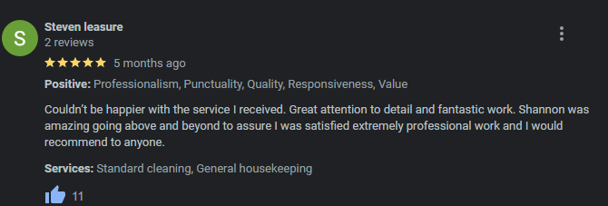
The Answer
Yes

Slide 30
330-929-3410
The Question
Do you need a TRUSTED cleaner?
You have 5 seconds

Slide 31
The Answer
Yes

Slide 32
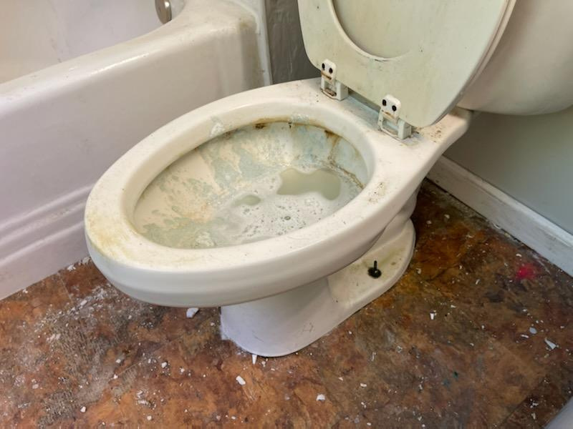
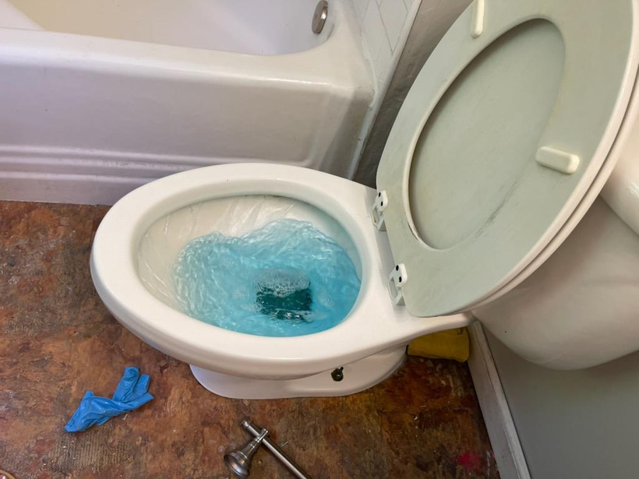
330-929-3410
The Question
Do you want to see Before and Afters?
You have 5 seconds

Slide 33
The Answer
Yes

Slide 35
330-929-3410

Slide 36
330-929-3410

Slide 37
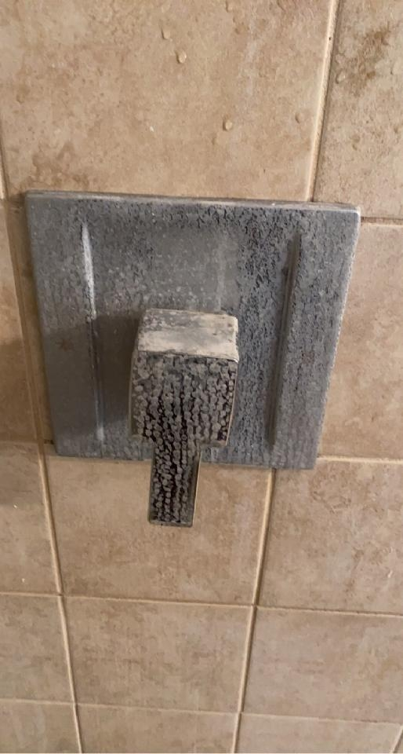
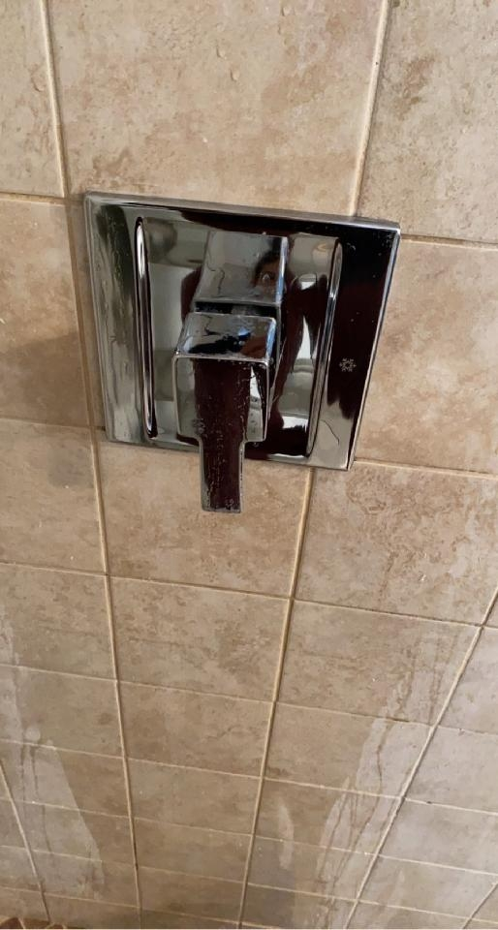
330-929-3410

Slide 38
330-929-3410

Slide 39
330-929-3410

Slide 40
330-929-3410

Slide 41
330-929-3410

Slide 43
330-929-3410

Slide 44
330-929-3410

Slide 45
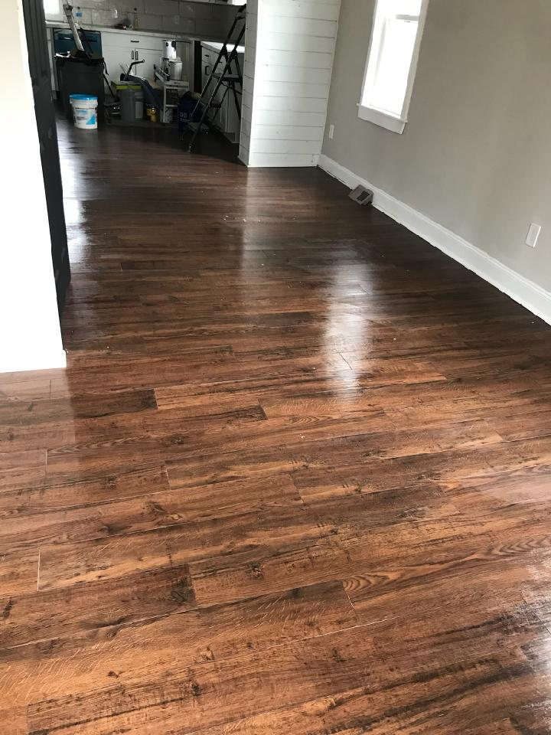
330-929-3410

Slide 46
330-929-3410

Slide 47
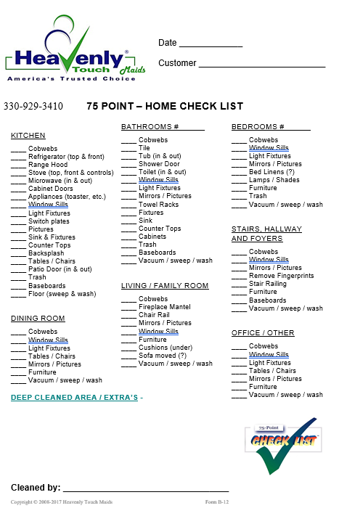
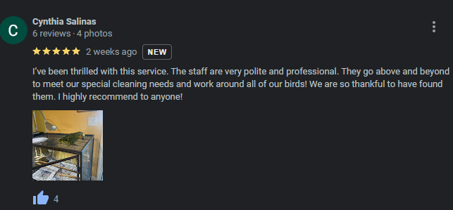

Slide 48
330-929-3410
The Question
Can we do for commercial what we do in your home?
You have 5 seconds

Slide 49
The Answer
Yes
The crew has been great. We are extremely pleased with your services. - Secure Recycle, Solon

Slide 50
330-929-3410

Slide 51
Stress Management
FOR THE WORKPLACE
Notes:
Workplaces can have many stressors. Issues in the workplace can exacerbate the risk of experiencing mental health challenges. Combined, these stressors can make it more difficult for workers to get their tasks done; threaten their productivity, happiness, and well-being; and lead to burnout. Because of the many potential stressors employees may be experiencing, a comprehensive approach is needed to address stressors throughout the community, and employers can be part of the solution. More than 85% of employees surveyed in 2021 by the American Psychological Association reported that actions from their employer would help their mental health.

Slide 52
Mandy McIntyre, Founder/Principal
Mental Health First Aid Instructor

Slide 53
WHAT TO EXPECT FROM THIS SESSION:
Mental health & stress overview
The impact of stress & mental health in the workplace
How to reduce stress & other proactive tactics
Resources to take action within your business

Slide 54
WHAT NOT TO EXPECT
FROM THIS SESSION:
To obtain all of the answers in one session
An absence of technical difficulties.
Feeling like you wasted your time by attending :)

Slide 55
TODAY'S GOAL:
To raise awareness around mental health & stress management for safer, happier, more engaged employees.

Slide 56
MENTAL HEALTH & STRESS OVERVIEW
Notes:
Over the course of your life, if you experience mental health problems your thoughts, mood and behavior could be affected. Many factors contribute to this including:
Biological such as brain chemistry
Family history
Life experience / trauma
Stress
**Stress is relative.

Slide 57
WHAT IS MENTAL HEALTH?
Mental health includes our emotional, psychological and social well-being.
-US Department of Health & Human Services
Source: US Department of Health & Human Services
Notes:
Over the course of your life, if you experience mental health problems your thoughts, mood and behavior could be affected. Many factors contribute to this including:
Biological such as brain chemistry
Family history
Life experience / trauma
Stress
**Stress is relative.

Slide 58
WHAT IS STRESS?
The body’s response to any kind of demand, good or bad.
ACUTE
CHRONIC
POST TRAUMA
Source: World Health Organization
Notes:
Stress is a normal reaction the body has when changes occur, resulting in physical, emotional and intellectual responses. Stress management training can help you deal with changes in a healthier way.
What is stress?
Stress is a normal human reaction that happens to everyone. In fact, the human body is designed to experience stress and react to it. When you experience changes or challenges (stressors), your body produces physical and mental responses. That’s stress.
Stress responses help your body adjust to new situations. Stress can be positive, keeping us alert, motivated and ready to avoid danger. For example, if you have an important test coming up, a stress response might help your body work harder and stay awake longer. But stress becomes a problem when stressors continue without relief or periods of relaxation.
https://my.clevelandclinic.org/health/articles/11874-stress
Good stress is short-term and it inspires and motivates you, focuses your energy and enhances performance. Bad stress, however, is the kind that wears you out, leaves you jittery and is harmful to your health. Bad stress, or distress, can lead to anxiety, confusion, poor concentration and decreased performance.

Slide 59
WHAT IS “BAD” STRESS?
Stress is your body's physical and psychological response to real or perceived threats that are overwhelming.
Source: World Health Organization
Notes:
Stress is your body's physical and psychological response to anything you perceive as overwhelming. This may be viewed as a result of life's demands, pleasant or unpleasant, and your lack of resources to meet them.

Slide 60
HOW DOES STRESS AFFECT US?
Source: World Health Organization
Notes:
FIGHT OR FLIGHT RESPONSE
A little bit of stress is good and can help us perform daily activities. Too much stress can cause physical and mental health problems. Learning how to cope with stress can help us feel less overwhelmed and support our mental and physical well-being.

Slide 61
CHRONIC STRESS & DISEASE
Medical research estimates 75% - 90% of illness and disease is
stress-related.
Source:
National Library of Medicine
Notes:
In addition, medical research estimates as much as 90 percent of illness and disease is stress-related. Stress can interfere with your physical functioning and bodily processes. High blood pressure, cardiovascular disease, and heart disease have been linked to stress factors. Other stress-related ailments include ulcers, allergies, asthma, and migraine headaches. Most health professionals agree stress can be a contributing factor in making existing medical problems worse.
https://www.ncbi.nlm.nih.gov/pmc/articles/PMC5476783/
https://nasdonline.org/1445/d001245/stress-management-for-the-health-of-it.html#:~:text=In%20addition%2C%20medical%20research%20estimates,been%20linked%20to%20stress%20factors.

Slide 62
Cortisol is an essential hormone that affects almost every organ and tissue in your body.
Nervous system.
Immune system.
Cardiovascular system.
Respiratory system.
Reproductive systems
Musculoskeletal system.
Integumentary system
(skin, hair, nails, glands and nerves).
Helping control your metabolism.
Suppressing inflammation.
Regulating blood pressure.
Regulating blood sugar.
Helping control your sleep-wake cycle.
Source: Cleveland Clinic
Notes:
Cortisol is a steroid hormone that your adrenal glands, the endocrine glands on top of your kidneys, produce and release.
Cortisol affects several aspects of your body and mainly helps regulate your body's response to stres
Your body continuously monitors your cortisol levels to maintain steady levels (homeostasis). Higher-than-normal or lower-than-normal cortisol levels can be harmful to your health.
Acute stress: Acute stress happens when you’re in sudden danger within a short period of time. For example, barely avoiding a car accident or being chased by an animal are situations that cause acute stress.
Chronic stress: Chronic (long-term) stress happens when you experience ongoing situations that cause frustration or anxiety. For example, having a difficult or frustrating job or having a chronic illness can cause chronic stress.
Traumatic stress: Traumatic stress happens when you experience a life-threatening event that induces fear and a feeling of helplessness. For example, experiencing an extreme weather event, such as a tornado, or experiencing war or sexual assault can cause traumatic stress. In some cases, these events can lead to post-traumatic stress disorder (PTSD).
Your body releases cortisol when you experience any of these types of stress.
https://my.clevelandclinic.org/health/articles/22187-cortisol

Slide 63
Notes:
Stress is not normally considered a mental health problem. But it is connected to our mental health in several ways: Stress can cause mental health problems. And it can make existing problems worse.

Slide 64
2022 HAD THE HIGHEST RATES OF SUICIDE
IN AMERICA THAN ANY OTHER YEAR ON RECORD PER THE CDC.
Source: CDC

Slide 65
THE PERFECT STORM:
NATIONAL MENTAL HEALTH CRISIS

Slide 66
STRESS & MENTAL HEALTH
IN THE WORKPLACE

Slide 67
OUR WORK ENVIRONMENTS PLAY A
SIGNIFICANT ROLE IN OUR LIVES.
Notes:
There are more than 160 million people who are a part of the U.S. workforce today.1 Work is one of the most vital parts of life, powerfully shaping our health, wealth, and well-being.2 At its best, work provides us the ability to support ourselves and our loved ones, and can also provide us with a sense of meaning, opportunities for growth, and a community. When people thrive at work, they are more likely to feel physically and mentally healthy overall, and to contribute positively to their workplace.3 This creates both a responsibility and unique opportunity for leaders to create workplace environments that support the health and well-being of workers.

Slide 68
Source: Mental Health America
MIND THE WORKPLACE REPORT

Slide 69
Source: Mental Health America
2022 MAKING THE CASE FOR MENTAL WELLNESS IN THE WORKPLACE GOOD FOR EMPLOYEES & GOOD FOR BUSINESS

Slide 70
STRESS:
Response
to changes & threats
(real or perceived)
BURNOUT:
Response
to prolonged
(chronic)
stress
Source: Cleveland Clinic
Notes:
stress is a response to a perceived threat.
burnout is a state of physical, emotional, and mental exhaustion caused by prolonged or excessive stress

Slide 71
“There is a workplace mental health crisis in America.
Burnout, exhaustion and hopelessness are more common among workers than ever before.”
Source: Mental Health America
2022 MAKING THE CASE FOR MENTAL WELLNESS IN THE WORKPLACE GOOD FOR EMPLOYEES & GOOD FOR BUSINESS

Slide 72
WORKPLACE CULTURE
STRESS RISK FACTORS
Mental health is not valued or prioritized
Poor supervision and management
Stigma and fear to ask for help
High pressure work environments
Access to healthcare & Work/life harmony
Lack of employee recognition & value

Slide 73
How Stress Affects Safety:
Stress is a distraction.
Stress can lead to shortcuts.
Stress can lead to toxic coping methods.
Stress can affect physical & mental health.

Slide 74
HOW TO REDUCE STRESS &
OTHER PROACTIVE TACTICS

Slide 75
EMPLOYER ACTION PLAN:
MANAGING STRESS: Be proactive and make mental health a safety and wellness initiative to protect your workforce.
COMMUNICATE: Navigate difficult conversations to reduce the stigma.

Slide 76
MANAGING STRESS IN THE WORKPLACE:
The Four A’s: Avoid, Alter, Adapt, Accept
Change the situation
(Employers)
Change the reaction
(Employees)
AVOID the stressor
ALTER the stressor
ADAPT to the stressor
ACCEPT the stressor
Notes:
four A’s: avoid, alter, adapt or accept.
Since everyone has a unique response to stress, there is no “one size fits all” solution to managing it. No single method works for everyone or in every situation, so experiment with different techniques and strategies. Focus on what makes you feel calm and in control.
Don’t try to control the uncontrollable – Many things in life are beyond our control –
particularly the behavior of other people. Rather than stressing out over the uncontrollable
situation, focus on the things you can control such as the way you choose to react to
problems.

Slide 77
MANAGING STRESS IN THE WORKPLACE:
Company culture assessments
Anonymous employee feedback surveys
Leadership reviews

Slide 78
MANAGING STRESS IN THE WORKPLACE:

Slide 79
MANAGING STRESS IN THE WORKPLACE:
Work / Life Harmony
& Self-Care

Slide 80
MAKE WORK FUN!

Slide 81
COMMUNICATION & STRESS
IN THE WORKPLACE

Slide 82
COMMUNICATION & STRESS
IN THE WORKPLACE
Lunch & Learns:
Promote insurance & EAP benefits
Invite a guest speaker or mental health professional

Slide 83
COMMUNICATION & STRESS
IN THE WORKPLACE

Slide 84
RESOURCES & EDUCATION

Slide 85
EDUCATION, TRAINING & RESOURCES
988 Suicide & Crisis Lifeline
www.samhsa.gov/find-help/988

Slide 88
Small employers (250 or less) in high risk industries:
Agriculture; automotive repair and service; construction; firefighters; health care; manufacturing; police and public safety; public employers; restaurant and food service; transportation and trucking; trash collection; wholesale and retail.

Slide 89
Notes:
https://www.ehstoday.com/safety-leadership/article/21255395/warning-the-workplace-could-be-hazardous-to-your-mental-health
https://www.hhs.gov/surgeongeneral/priorities/workplace-well-being/index.html

Slide 92
MENTAL HEALTH FIRST AID

Slide 96
Company culture assessments
DEI programs & training
Leadership development
Stress management & wellness programs
Ergonomics
Harassment prevention programs
EOS fractional integrator

Slide 97
GOAL RECAP:
To raise awareness around mental health & stress management for safer, happier, more engaged employees.

Slide 98
REASON FOR OUR GOAL:
National mental health crisis
Stress affects the safety & productivity of your workforce
Workplace stress and burnout is at crisis levels nationwide
Because your team deserves it and your company will benefit from mental health initiatives

Slide 99
HOW TO REACH OUR GOAL:
PROACTIVE APPROACH: make stress management & mental health a safety and wellness initiative to protect your workforce.
COMMUNICATE: Navigate difficult conversations to reduce the stigma.
EDUCATION & RESOURCES:
Provide training and support.

Slide 100
THANK YOU!
www.levelup-mentalhealth.com
Website : www.levelup-consultants.com
Email : mmcintyre@levelup-consultants.com
mmcintyre@levelup-consultants.com
+216-409-8537

Slide 102
May 8th
De-Escalation with Patrick Johnson, PRADCO
June 12th
First Aid Basics with Aubi Nemeth, Sixth City CPR

