Slide 2
Slides, External resources & registration can be found at www.solonchamber.com/slides
Materials will also be distributed by email after the program!

Slide 3
September 13th
Basic Electrical Safety with Andrew Johnson, Sotaris
October 11th
Workplace Fire Safety with Brian DiRocco, Solon Fire Rescue

Slide 4
Private Employers Important Dates
Aug 15
Payroll true-up deadline
Aug 31
DFSP Safety Action Plan (DFSP-5) advanced level due
Notes:
Read slide

Slide 5
Public Employers Important Dates
None coming up

Slide 6
NEW!!!!! BWC Grants Program
1,000 safety grant applications of all types for over $20.5 million were approved!
The Firefighter Exposure to Environmental Elements Grant (FEEEG) will now be on a three-year eligibility cycle with dryers and PPE cleaners now being additional eligible items. Eligible employers will be able to apply for up to $15,000 every three years. Volunteer Fire depts. can apply for turnout gear.
The School Safety and Security Grant (SSSG) will now be on a three-year eligibility cycle. Eligible employers will be able to apply for up to $40,000 every three years.
The Employer working with Person with Developmental Disabilities (EWPDD) grant and Workplace Wellness Grant programs have phased out due to decreasing enrollment.

Slide 7
Grants Program
Funding opportunities are once again available for our special safety grant programs.
Trench Safety Grant. Available only to Ohio employers that perform trenching and excavating.
Firefighter Exposure to Environmental Elements Grant combats firefighter cancer risk.
School Safety and Security Grant provides assistance to Ohio employers with ensuring the safety of their staff who instruct children throughout the state.

Slide 8
Safety Intervention Grants Program
Items Not Eligible
Equipment primarily necessary for the business (e.g., forklift).
Items that are not engineering controls (e.g., PPE).
Items that don’t directly reduce workplace risk factors (e.g., lighting).
Other items outside the scope of the program (e.g., insurance).
Equipment intended to meet minimum OSHA compliance, including basic machine guarding devices and equipment, standard guardrailing systems, etc.

Slide 9
Grants Programs cont’d. Safety Intervention Grants Program
Purchase equipment to eliminate or significantly reduce hazards in the workplace.
3:1 match up to $40,000
Renewable every 3 years
One year case study/annual report
In business for one year

Slide 10
NEW!!!!! BWC Grants Program
NOW ELIGIBLE!!!
Powered cots without a loading system.
Vehicle lifts outside of the vehicle service industry.
Crash attenuators intended to protect employees.
Food portioning equipment, except for deli slicers.
Oil filtration systems for fryers.
Truck/trailer restraints or dock leveling systems
Wire/cable stripping equipment.
Seated equipment that’s primary purpose is not to move or transport people, equipment, or supplies.

Slide 11
An Overview of Ohio EPA Regulatory Programs, Common Violations & How to Prevent Them
Western Reserve Safety Council
August 9, 2023

Slide 12
Today’s Discussion
Major areas of regulation
Common violations
Preventing common violations
Finding help
Finding funding

Slide 13
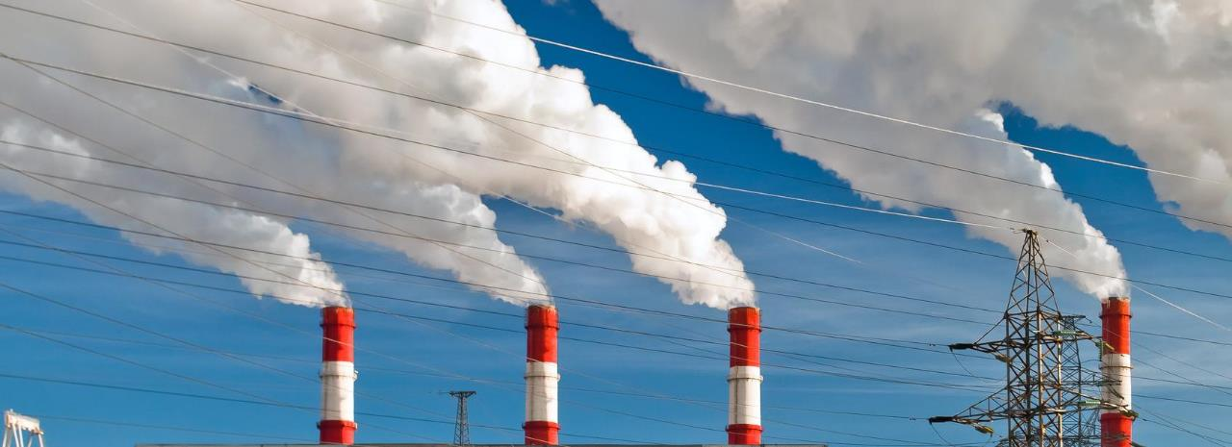
Air Permitting

Slide 14
Sources of air pollution need an air permit
unless they are exempt

Slide 15
What needs an air permit?
No set list of what needs an air permit
Some exemptions exist
Need to evaluate your air pollution sources
No list
Learn More
Air Permit Exemptions

Slide 16
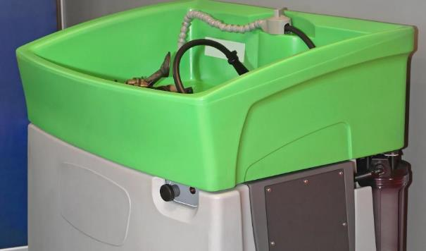
Common Permitted Sources
Spray Booth
Solvent Degreaser

Slide 17
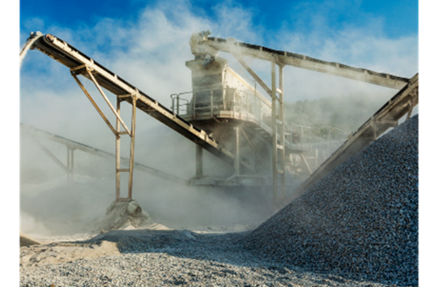
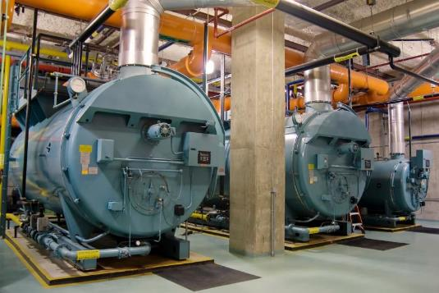
Common Permitted Sources
Aggregate Processing
Large boilers

Slide 18
Common Permitted Sources
Solvent Drycleaning
Printing Operations

Slide 19
Common Air Permit Violations
Not evaluating all air pollution sources
Operating without an air permit
Failing to keep required records
Not re-evaluating permit needs if operations or equipment changes

Slide 20
Tips To Avoid Air Permit Violations
EVALUATE YOUR FACILITY
● Evaluate your operations
● Identify air pollution sources

Slide 21
Tips To Avoid Air Permit Violations
CONSIDER EXEMPTIONS
Air Permit Exemptions

Slide 22
Tips To Avoid Air Permit Violations
UNDERSTAND RECORDKEEPING
● Many ways to track
● Keep it simple

Slide 23
Tips To Avoid Air Permit Violations
RE-EVALUATE AS NEEDED
● Operational changes
● Equipment changes

Slide 24
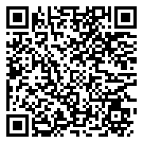
Need help evaluating?
See our
Video Tutorial

Slide 25
Wastewater Permitting

Slide 26
Discharging wastewater to “waters of the state”
requires a permit

Slide 27
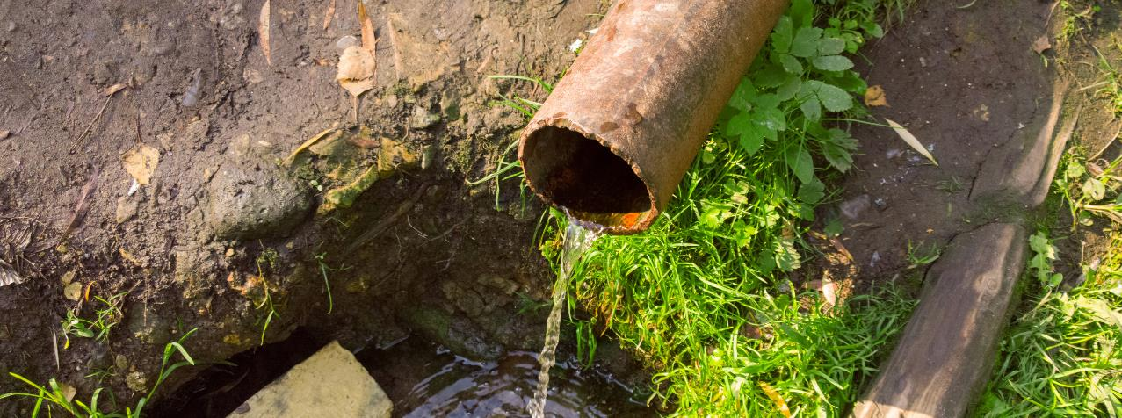
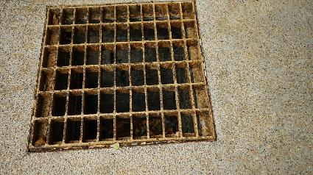
Direct Discharges
Indirect Discharges
Indirect Discharges

Slide 28
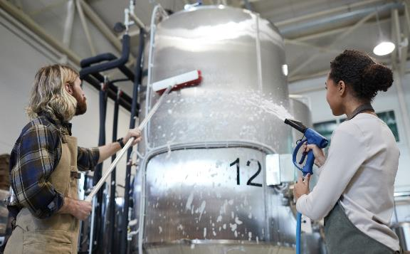
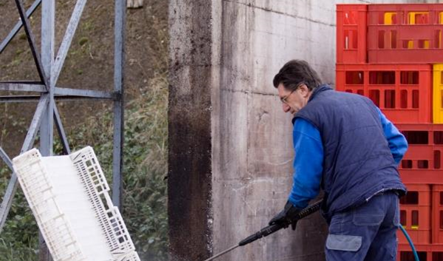
Wastewater From
Equipment cleaning
Power washing

Slide 29
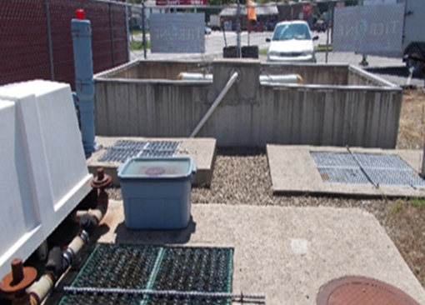
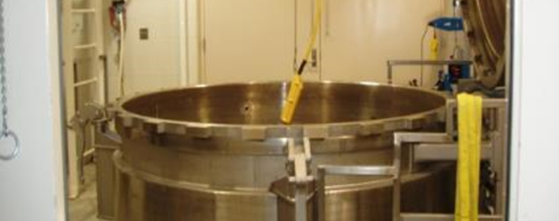
Wastewater From
Discharging septic systems
Industrial processes

Slide 30
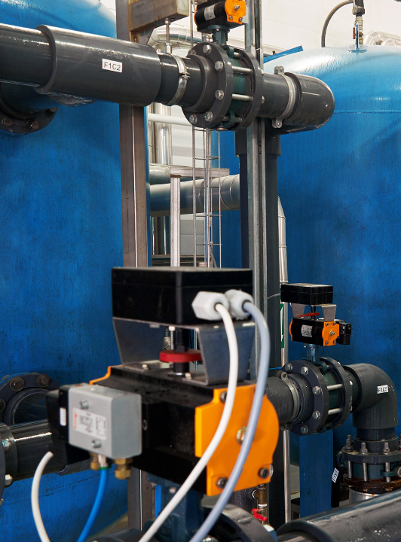
Wastewater Pretreatment System
Additional approval & permits needed

Slide 31
Common Wastewater Violations
Discharging wastewater without a permit
Not completing permit reporting and monitoring

Slide 32
Tips To Avoid Wastewater Violations
UNDERSTAND YOUR WASTEWATER
● Know where you generate wastewater
● Know your discharge locations

Slide 33
Tips To Avoid Wastewater Violations
ELIMINATE ANY UNAUTHORIZED DISCHARGES

Slide 34
Tips To Avoid Wastewater Violations
PERMIT AUTHORIZED DISCHARGES & PRE-TREATMENT SYSTEMS

Slide 35
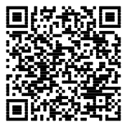
Need more help?
Wastewater Permit Webpage

Slide 36
Industrial Stormwater Permitting

Slide 37
Discharging stormwater to “waters of the state”
may require a permit

Slide 38
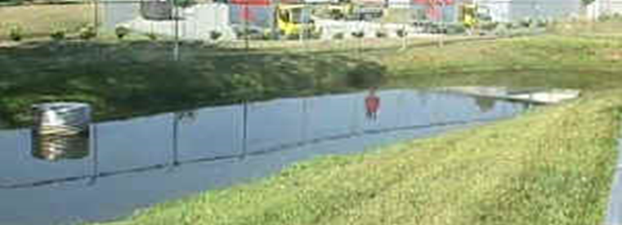
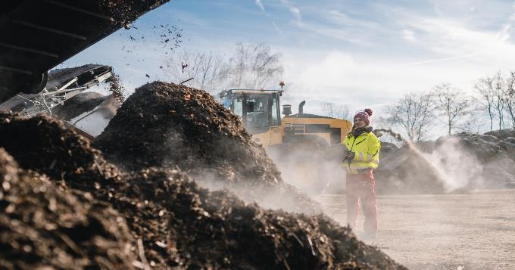
Industrial Stormwater From
Certain industrial operations
Based on your Standard Industrial Classification (SIC) Code

Slide 39
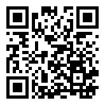
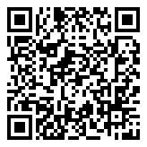
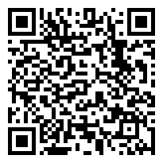
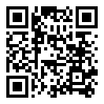
Industrial Stormwater Permit
Need help?
What is your SIC code?
Is your SIC listed?
Qualify for No Exposure exemption
OR
Do you qualify for the No Exposure exemption?
Your SIC code is listed
How do you apply for the stormwater permit?
Obtain stormwater permit

Slide 40
Common Stormwater Violations
Discharging stormwater without a permit
Not developing or complying with SWPPP

Slide 41
Tips To Avoid Stormwater Violations
DETERMINE IF PERMITS APPLY
● Know your SIC code
● Evaluate No Exposure exemption

Slide 42
Tips To Avoid Stormwater Violations
IMPLEMENT EFFECTIVE STORMWATER MANAGEMENT PRACTICES

Slide 43
Need more help?
Industrial stormwater webpage
Industrial stormwater SWPPP tips webinar
Construction stormwater webinar

Slide 44
Hazardous Waste Management

Slide 45
You should not throw anything in the trash until you have determined that it is
NOT hazardous waste

Slide 46
Waste Management
Specific requirements for managing hazardous waste
Requirements depend on generator category
Some wastes have alternate management options

Slide 47
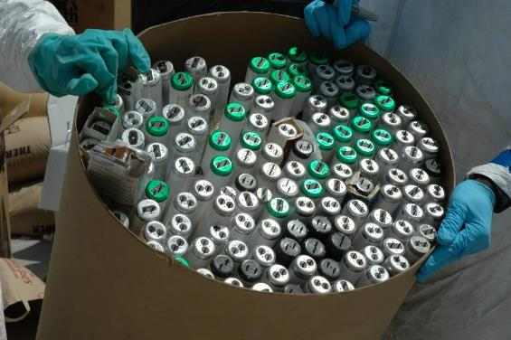
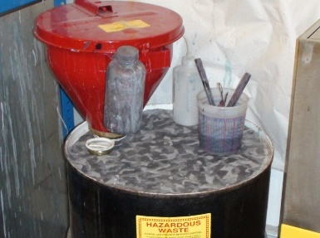
Commonly Generated Hazardous Waste
Spent lamps/bulbs
Waste paints/solvents

Slide 48
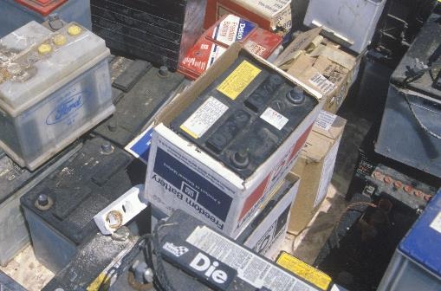
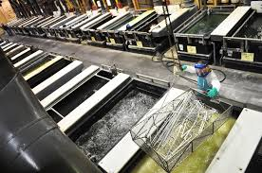
Commonly Generated Hazardous Waste
Spent batteries
Spent plating solutions

Slide 49
Alternate Management Standards
Universal Waste
Specific hazardous wastes
Do not count towards your hazardous waste generator status
Waste evaluation not required
Encourages recycling
Universal Waste
Take advantage of UW rules to reduce your regulatory burden

Slide 50
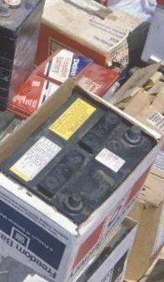
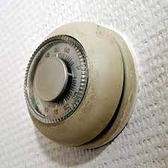
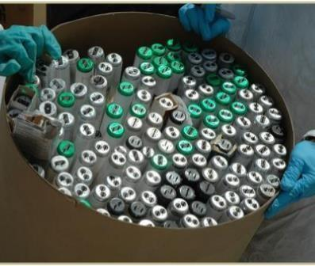
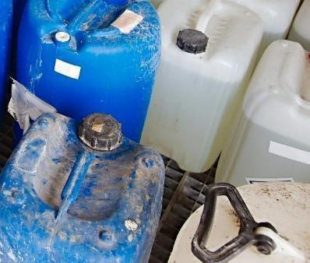
Universal Waste
Aerosol Cans
Mercury-Containing Devices
Waste Lamps
Discarded Batteries
Recalled Pesticides

Slide 51
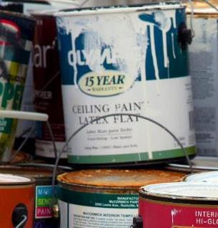
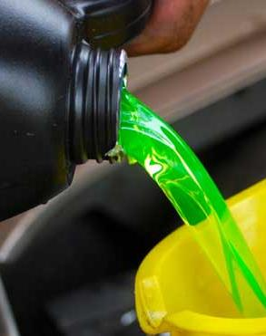
Ohio-Specific Universal Waste
Paint/Paint-Related Waste
Antifreeze

Slide 52
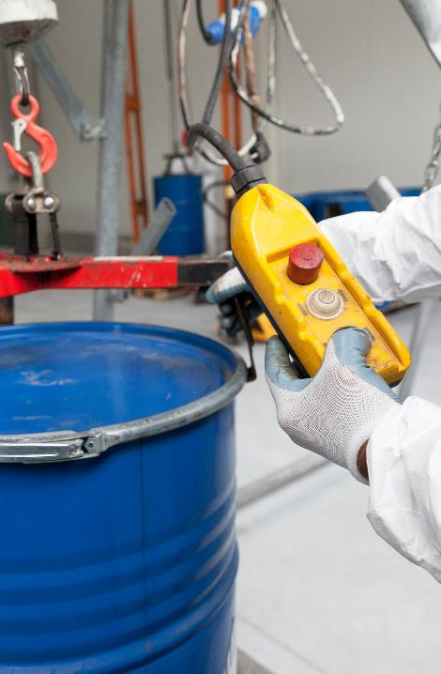
Common Hazardous Waste Violations
Not evaluating waste
Not knowing your generator category
Not managing wastes properly

Slide 53
Tips To Avoid Hazardous Waste Violations
THINK BEFORE YOU THROW IT OUT!
● Don’t throw it out unless you have demonstrated it is NOT hazardous waste

Slide 54
Tips To Avoid Hazardous Waste Violations
KNOW YOUR GENERATOR CATEGORY & THE CATEGORY REQUIREMENTS

Slide 55
Tips To Avoid Hazardous Waste Violations
TAKE ADVANTAGE OF UW RULES
UW does not count toward your hazardous waste generator totals

Slide 56
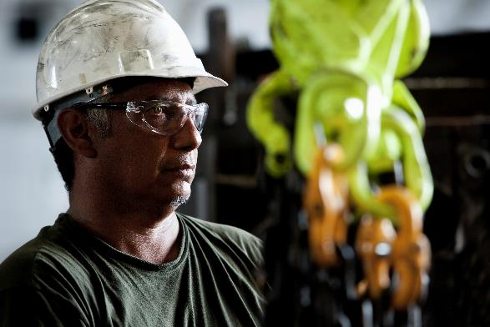
Need more help?
Haz. Waste Generator Guidance
Haz. Waste 101 Webinar

Slide 57
Navigating Environmental Regulations Can Be Complex
OCAPP can help!

Slide 58
We Can Help
Office of Compliance Assistance and Pollution Prevention (OCAPP)

Slide 59
What is OCAPP?
Non-regulatory
Confidential Program
Help Business/Communities:
-Achieve Compliance
-Reduce Waste
-Prevent Pollution
We are a “One-Stop Shop”

Slide 60
Who is OCAPP?
OCAPP
NE Ohio OCAPP Contacts
Miranda Garritano
Tamara Girard
EAU
RSU
Environmental Assistance Unit
Recycling & Sustainability Unit
Tamara Girard

Slide 61
OCAPP Confidentiality
By law OCAPP cannot share information about our customers with Ohio EPA inspection or enforcement staff
All OCAPP services are free and confidential
CONFIDENTIAL

Slide 62
How ocapp can help you?

Slide 63
Provide Regulatory Technical Assistance
On-site compliance assessments
Phone consultations
Toll-free hotline (Mon - Fri 8 a.m. – 5 p.m.)
Live Chat (Mon - Fri 8 a.m. – 5 p.m.)
(800) 329-7518 Toll-free compliance hotline
Live compliance chat line
Access live chat

Slide 64
Explain Regulatory Requirements
Help you understand:
What regulations apply
How to comply

Slide 65
Help With Regulatory Paperwork
Permit evaluations
Permit applications
Regulatory recordkeeping
Regulatory reporting

Slide 66
Provide Technical Information & Guidance
Technical webinars
Compliance newsletter
Web resources
FAQs/Answer Place
Permit Wizard
Workshops and conferences
Publications (in plain-English)
Compliance calendar

Slide 67
Recognize Your Regulatory Compliance & Environmental Stewardship Efforts
E4: Public or private K-12 schools
19 awardees since 2019
E3: Business, industry, trade association
234 awardees since 2015
E3C: Local governments and communities
8 awardees since 2021
Learn More

Slide 68
Reduce Waste, Save Money, & Be More Sustainable
Pollution Prevention (P2)
Process-focused on-site assessments
Reduce waste
Prevent pollution
Save money
Reduce regulatory requirements
Technical resources and information

Slide 69
Provide Money for Recycling & Litter Prevention
Recycling  Litter Prevention  Scrap Tire Management  Market Development
In 2022, more than $6.2 million was provided to 181 grant applicants.
Learn More

Slide 70
Manage Difficult Waste Streams
2022 Monetary Savings
$58,590
Free online platform to help businesses
Find a market for unwanted materials
Access other’s unwanted materials
Ohio Materials Marketplace (OMM)
$297,140 Total Program Savings
TONS
63,122
Diverted from landfill in 2022

Slide 71
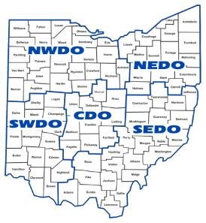
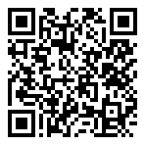
How to Request OCAPP Assistance
Call Us
Call your Northeast Ohio OCAPP specialist directly
Miranda Garritano
Toll-free compliance hotline
miranda.garritano@epa.ohio.gov
(800) 329-7518
330.963.1250
Mon. – Fri. 8 a.m. to 5 p.m.
Tamara Girard
tamara.girard@epa.ohio.gov
330.963.1282
Need help in another part of the state?
Find your OCAPP compliance specialist

Slide 72
THANK YOU

Slide 73
Slides, External resources & registration can be found at www.solonchamber.com/slides
Materials will also be distributed by email after the program!

Slide 74
September 13th
Basic Electrical Safety with Andrew Johnson, Sotaris
October 11th
Workplace Fire Safety with Brian DiRocco, Solon Fire Rescue

