Slide 2
Slides, External resources & registration can be found at www.solonchamber.com/slides
Materials will also be distributed by email after the program!

Slide 3
January 10th
2024 HR Compliance Toolkit with Elizabeth Crosby, Buckley King
February 14th
Fall Protection with Dave Dennison, Flaherty Sales

Slide 10
Important Dates – Private Employers
Dec. 29
Deadline for Grow Ohio safety requirements if coverage became effective between Jan. 1 and June 30

Slide 11
Important Dates – Public Employers
Dec. 21
First installment due for PY 2024
Dec. 31
Industry-Specific Safety Program (ISSP) deadline to complete loss prevention activities
Policy Activity Rebate (PAR) deadline to complete and record activities
Jan. 1
Payroll true-up period
Jan. 3
Early payment discount

Slide 12
Webinars
Precision OSHA recordkeeping Jan. 10
Training the Next Generation Jan. 23
Each individual attending should register in the BWC Learning Center

Slide 13
Virtual Classes
OSHA Recordkeeping Half-day Workshop Dec. 14
Electrical Hazard Recognition and Abatement Jan. 9-12
Developing a Driver Safety Program Jan. 9
Hazardous Waste Op’s & Emergency Resp Awareness Jan. 18
Hazardous Waste Op’s & Emergency Response
Series Module 4: Air Monitoring, Work Zones Jan. 22
Controlling Workers Compensation Costs Jan. 30-31
Trenching and Excavation Jan. 30-Feb. 1
Each individual attending should register in the BWC Learning Center

Slide 14
In-Person Classes
OSHA 10: Construction Safety Basics (Youngstown) Jan. 9-10
Job Safety Analysis (Cleveland) Jan. 11
Each individual attending should register in the BWC Learning Center

Slide 16
2024 Ohio Safety congress & expo®
LEARN, SOLVE and CONNECT
March 27-29
Greater Columbus Convention Center
Columbus, OH

Slide 17
150+ Educational sessions 14+ interactive workshops
OSC24® will offer:
13 educational tracks
General Credit (IACET), Human Resources (HRCI, SHRM), Nurse (RN,LPN), and Attorney continuing education credits.
BWC rebate and other program credits – One Claim Program, Group-Experience Rating, 100-Percent EM Cap, and Safety Council Rebate Program.
Note: In addition to in-person sessions, a select number of sessions will be live-streamed. Continuing education credits and BWC credits and rebates are exclusively awarded for in-person attendance. Virtual attendance alone does not qualify for these credits.
Start Planning Now!
All OSC24® sessions, descriptions, and speakers can now be viewed AT OHIOSAFETYCONGRESS.COM

Slide 18
Hotel reservations
Hurry! A limited number of OSC24® rooms are contracted.
Make your reservation now to secure the event discounted rate at one of seven downtown Columbus hotels connected to or within walking distance of the convention center.
Hilton Columbus Downtown
Hyatt Regency Columbus
Drury Inn & Suites Columbus Convention Center
Hampton Inn & Suites Columbus Downtown
Red Roof Plus Columbus Downtown
Sonesta Columbus Downtown
Courtyard by Marriott Columbus Downtown
If you require 10 or more rooms, please send an email to Housing@ExperienceColumbus.com.

Slide 19
Registration opens in January
Questions?
Contact Us
SafetyCongress@bwc.ohio.gov
Call or text 614-800-5221

Slide 20
Grants Program
Funding opportunities are once again available for our special safety grant programs.
Trench Safety Grant* for Ohio employers that perform trenching and excavating.
Firefighter Exposure to Environmental Elements Grant combats firefighter cancer risk.
School Safety and Security Grant provides assistance to Ohio employers with ensuring the safety of their staff who instruct children throughout the state.
Safety Intervention Grant assists to purchase equipment to substantially reduce or eliminate injuries and illnesses associated with a particular task or operation.
*One time grant, all others renewable after 3 years.

Slide 21
Unleashing the Power of Sustainability: A Strategic Business Approach for a Brighter Future
Adriana Townsend
August Mack Sustainability Manager

Slide 22
August Mack Environmental: Who we are
6 offices: Indianapolis (HQ), Cleveland, Columbus, Livonia (MI), Lancaster (PA), Philadelphia (PA)
190+ employees across our geography
Diverse staff of experienced environmental professionals with backgrounds in geology, engineering, environmental science, hydrogeology and chemistry
Certifications as Licensed Professional Geologists, Asbestos Inspectors, Professional Engineers, Certified Wastewater Treatment Plant Operators, Certified Hazardous Materials Managers, UST Professionals, and more
Compliance, Due Diligence, Closure/Remediation, Building Sciences, Construction Service, Water Resources, Sustainability

Slide 23
Goals for today
Overview of Sustainability
What?- Defining sustainability & understanding what’s driving sustainability in the business world
Sustainability and EH&S: The Overlap
Why it’s relevant to EH&S managers
Requests we’ve had from EH&S managers regarding sustainability
Sustainability and safety

Slide 24
Sustainability- what?
Defining Sustainability

Slide 25
Sustainability- What?
Defining Sustainability
What is “sustainability?”
...like, literally what is it?....
The literal definition:
“...the ability to maintain something for a prolonged period at a constant rate”
Example: Hold your breath underwater...Doable? Sustainable (think long term)?

Slide 26
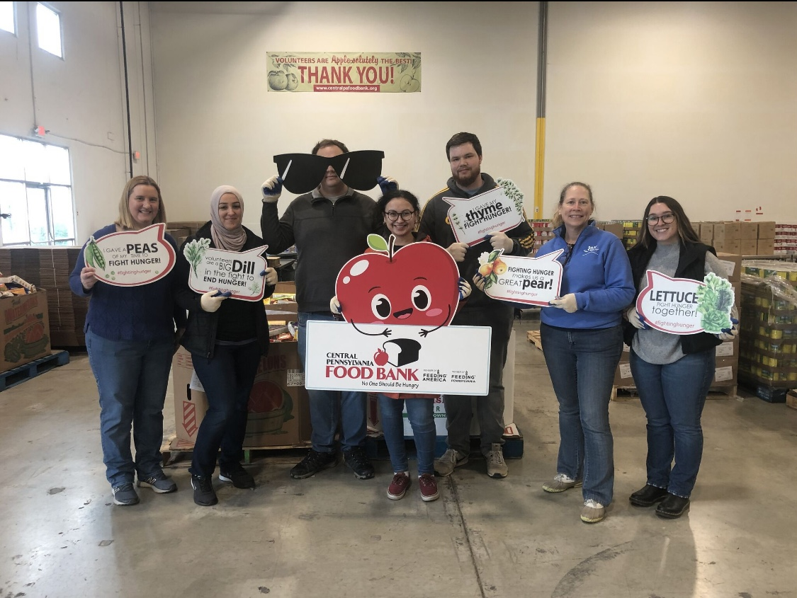
Sustainability- What?
Defining Sustainability
“Applied” sustainability is...
An all-encompassing word describing business practices that are well balanced in environmental, social, and governance (ESG) factors
Actively evolving
Widely supported by large investors such as BlackRock

Slide 27
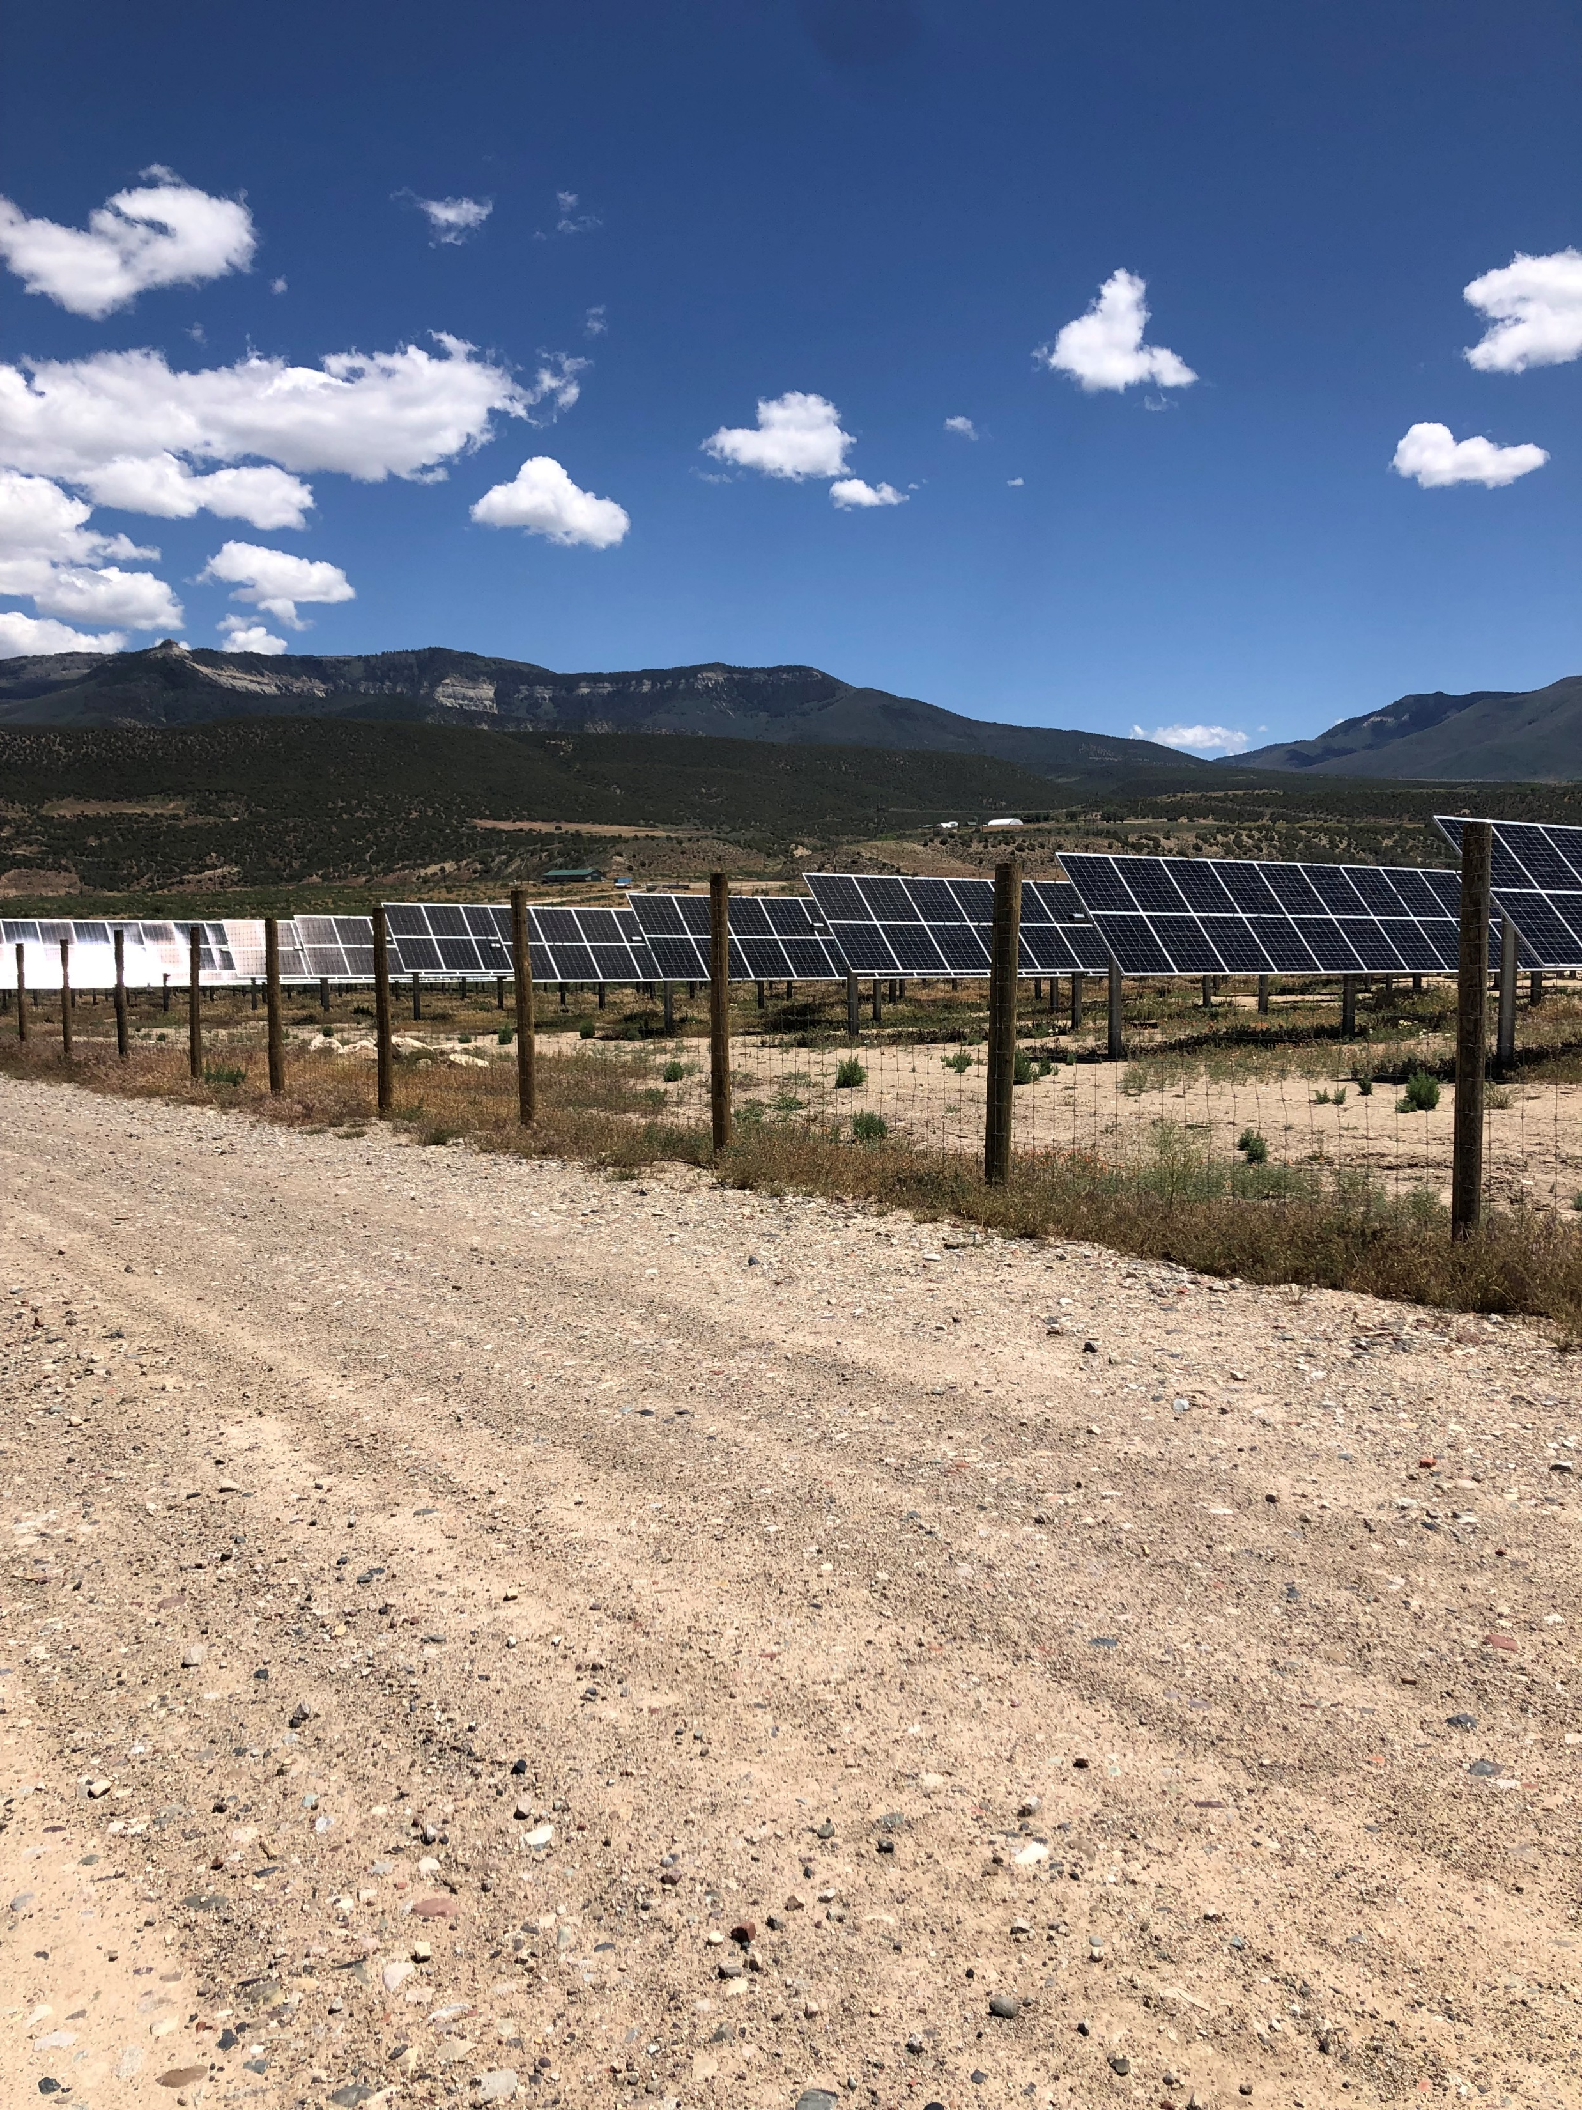
Sustainability- What?
ESG
Environmental
Energy usage/emissions
Water usage
Waste streams
Recycling
Social
Employee metrics (gender ratios, turnover rate, engagement)
Community involvement
Health & safety
Governance
Management diversity
Data privacy
Company values

Slide 28
Sustainability- what?
What is driving sustainability?
$$$
Pleases stakeholders (investors, employees, customers, clients, etc.)
Improves public image
It’s ethical ;)

Slide 29
Sustainability and EH&S
The Overlap

Slide 30
Sustainability and EH&S: the overlap
ESG & EH&S
Environmental
Social
Health & Safety
Health & Safety

Slide 31
Sustainability and EH&S: the overlap
Requests we’ve had from EH&S managers:
Greenhouse gas (GHG) emissions (Scope 1 and Scope 2)
Energy reduction goals/energy audits
Water reduction goals/water audits
CDP reporting (Walmart)
EcoVadis reporting (Honda, ABB, U.S. Steel)
Health & Safety

Slide 32
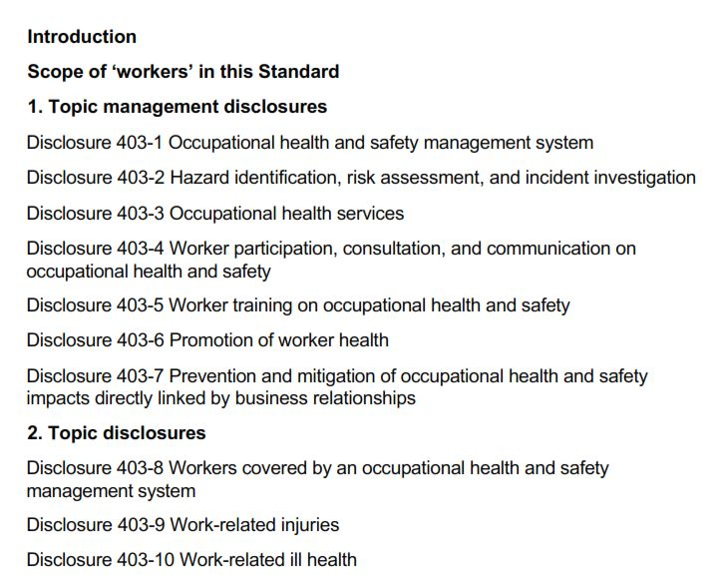
Sustainability and H&S: the overlap
Global Reporting Initiative (GRI) 403: Occupational Health and Safety

Slide 33
Sustainability
Summary
Sustainability is broad
Can impact internal workforce and business operations/partnerships
Market driven
Don’t get left behind

Slide 34
Questions?
August Mack Environmental
Adriana Townsend
Sustainability Manager
atownsend@augustmack.com
C: 570-317-8277

Slide 35
Slides, External resources & registration can be found at www.solonchamber.com/slides
Materials will also be distributed by email after the program!

Slide 36
January 10th
2024 HR Compliance Toolkit with Elizabeth Crosby, Buckley King
February 14th
Fall Protection with Dave Dennison, Flaherty Sales

