Slide 2
Program Sponsor

Slide 3
Program Sponsor

Slide 4
Slides, External resources & registration can be found at www.solonchamber.com/slides
Materials will also be distributed by email after the program!

Slide 5
February 14th
Fall Protection with Dave Dennison, Flaherty Sales
March 13th
BWC Programs & Rebates with Lorrie Goodnight, Bureau of Workers' Comp.

Slide 13
Important Dates – Private Employers
Jan. 31
Private employer program application deadline

Slide 14
Important Dates – Public Employers
Jan. 1 – Feb. 15
Payroll True-up period
Feb. 1
300 AP due

Slide 15
Employer Webinars
BWC website updates
Experience modifiers (EMs) and how they are calculated
Transitional work
Important dates
Monthly safety tip
Date: 11:30 a.m. Thursday, January 25

Slide 16
Webinars
Precision OSHA recordkeeping* Jan. 10 (9:30 am)
Training the Next Generation
Jan. 23 (10 am)
Guidelines to setting up an employee recognition program
Feb. 7 (1:30 pm)
*OSHA Recordkeeping 101 online
Each individual attending should register in the BWC Learning Center

Slide 17
Virtual Classes
Hazardous Waste Op’s & Emergency Resp Awareness
Jan. 18
Hazardous Waste Op’s & Emergency Response
Series Module 4: Air Monitoring, Work Zones Jan. 22
Controlling Workers Compensation Costs Jan. 30-31
Trenching and Excavation Feb. 5-7
Electrical Safety (NFPA 70E) Feb. 7-8
Hazardous waste Module 6: incident command system and termination
Feb. 12
Each individual attending should register in the BWC Learning Center

Slide 19
2024 Ohio Safety congress & expo® ^{March 27-29}

Slide 20
Keynote speaker
March 28, 2024
9 a.m.
Eduardo garcia
Survival story with amazing ability to adapt and exceed
Chef Eduardo Garcia’s culinary passion collided with life’s harsh realities in 2011 when a startling incident left him fighting for survival.
Shot with 2400 volts of electricity and miles from help, he not only survived but turned years of recovery into a compelling tale of resilience.

Slide 21
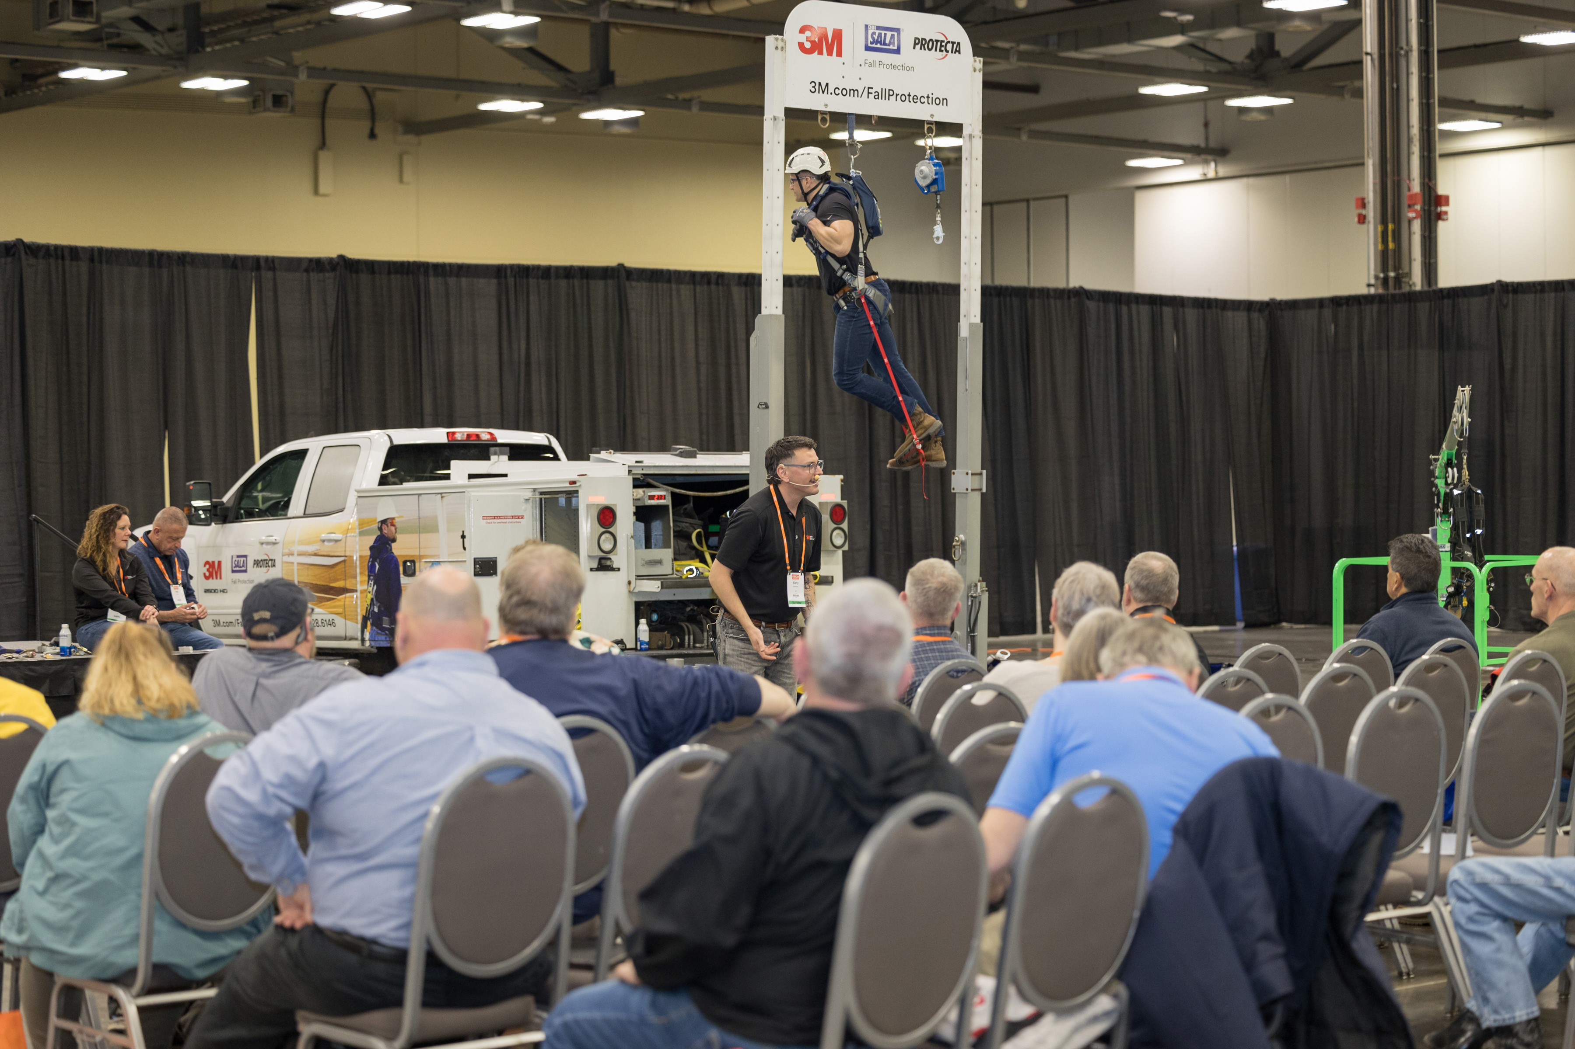
Visit the knowledge hub
When you register, build your schedule by selecting the educational sessions of your choice. The Knowledge Hub is an additional option for an unconventional learning experience.
OSC24® dedicates specialized space in the Expo Marketplace for large-scale educational sessions to elevate your understanding in an immersive environment.
Although Knowledge Hub sessions do not offer continuing education credit, the unique learning topics presented may meet your specific job-related needs.
High voltage safety - - OUPS - - Fall protection - - Equipment usage - - Confined space

Slide 22
Experience the expo
Expect nearly 300 exhibitors!

Slide 23
Questions?
Contact Us
SafetyCongress@bwc.ohio.gov
Call or text 614-800-5221

Slide 24
Injury and illness data submission begins January 2, 2024
The New Requirements
Certain establishments must electronically submit to OSHA detailed information about each recordable injury and illness entered on their previous calendar year's OSHA 300 Log and 301 Incident Report forms (29 CFR 1904.41). This includes the date, physical location, and severity of the injury or illness; details about the worker who was injured; and details about how the injury or illness occurred.
Only establishments with 100 or more employees in designated industries are required to submit case-specific information from the OSHA Form 300 Log and the OSHA Form 301 Incident Report.
Establishments that had a peak employment of 100 or more employees during the previous calendar year meet this size criteria.
The designated industries are listed in Appendix B to Subpart E of 29 C.F.R. Part 1904.
One way to determine if your establishment(s) is required to report these data is by using our ITA Coverage Application.
The requirements apply to establishments covered by Federal OSHA, as well as establishments covered by states with their own occupational safety and health programs (i.e., State Plans).
The data must be electronically submitted through OSHA's Injury Tracking Application (ITA). There are 3 ways to submit the data: (1) webform on the ITA, (2) submission of a csv file to the ITA, or (3) use of an application programming interface (API) feed. The ITA will begin accepting 2023 injury and illness data on January 2, 2024. The due date to complete this submission is March 2, 2024. The submission requirement is annual, and the deadline for timely submission of the previous year's injury and illness data will be on March 2 of each year.
Notes:
Complementary copies of OSHA fact sheet may be vailable at meeting.

Slide 25
Ohio.gov | OCSWA | Winter Health & Safety Tips
Notes:
Good simple info to share at safety meetings, newsletter, bulletin boards

Slide 26
Grants Program
Funding opportunities are once again available for our special safety grant programs.
Trench Safety Grant* for Ohio employers that perform trenching and excavating.
Firefighter Exposure to Environmental Elements Grant combats firefighter cancer risk.
School Safety and Security Grant provides assistance to Ohio employers with ensuring the safety of their staff who instruct children throughout the state.
Safety Intervention Grant assists to purchase equipment to substantially reduce or eliminate injuries and illnesses associated with a particular task or operation.
*One time grant, all others renewable after 3 years.

Slide 27
Program Sponsor
Melanie Maulding and Ryan O’Dea
melanie.maulding@cbiz.com
ryan.odea@cbiz.com
216.447.9000
www.cbiz.com

Slide 28
LET’S GET READY FOR 2024!
Buckley King LPA
h.r. compliance update

Slide 29
H.R. 2024 PREP!
UPDATE or CREATE HANDBOOK

Slide 30
H.R. 2024 PREP!
UPDATE or CREATE HANDBOOK
Leave & Time away policies
Accommodations
Harassment, Reporting & Retaliation
Tracking Time
Standards of Conduct
Marijuana/Substances

Slide 31
H.R. 2024 PREP!
JOB DESCRIPTIONS

Slide 32
H.R. 2024 PREP!
JOB DESCRIPTIONS
Title of Job
Define “Essential Functions” meaning things that make the job what it is
Physical Requirements
For Recruiting
Experience, credentials, shifts?

Slide 33
H.R. 2024 PREP!
WAGE & HOUR COMPLIANCE

Slide 34
H.R. 2024 PREP!
WAGE & HOUR COMPLIANCE
MINIMUM WAGE FOR 2024
$10.45/HR NON-TIPPED EMPLOYEES
$5.25/HR TIPPED EMPLOYEES

Slide 35
H.R. 2024 PREP!
WAGE & HOUR COMPLIANCE
Review Exemptions
Salary basis?
Minimum salary test? ($35,568)
Check DOL Worksheets 17A & 17C
Ohio Overtime – time & half for hours over 40 in a work week

Slide 36
H.R. 2024 PREP!
Pregnancy Workers Fairness Act
(“PWFA”)

Slide 37
H.R. 2024 PREP!
Pregnancy Workers Fairness Act (“PWFA”)
Took effect June 27, 2023
Requires covered employers to provide reasonable accommodations to a worker's known limitations related to pregnancy, childbirth, or related medical conditions, unless the accommodation will cause the employer an undue hardship.
Enforce/administer in tandem with ORC 4112
Written policy
Job protection during “Reasonable Leave”

Slide 38
H.R. 2024 PREP!
NEW OSHA REQUIREMENTS

Slide 39
H.R. 2024 PREP!
NEW OSHA REQUIREMENTS
Starting January 2024, employers in specific high-risk industries must use OSHA's electronic reporting system, the Injury Tracking Application (ITA), to submit detailed information on workplace injuries and illnesses.

Slide 40
H.R. 2024 PREP!
NEW OSHA REQUIREMENTS
https://www.osha.gov/injuryreporting/ita/

Slide 41
H.R. 2024 PREP!
NEW OSHA REQUIREMENTS
Applies to establishments with 100 or more employees in designated industries ;
Establishments that had a peak employment of 100 or more employees during the previous calendar year meet this size criteria.
The designated industries are listed in Appendix B to Subpart E of 29 C.F.R. Part 1904.
To determine if your establishment(s) is required to report these data is by using our ITA Coverage Application.
The requirements apply to establishments covered by Federal OSHA, as well as establishments covered by states with their own occupational safety and health programs (i.e., State Plans).

Slide 42
H.R. 2024 PREP!
MARIJUANA

Slide 43
H.R. 2024 PREP!
MARIJUANA
Ohio became the 24th state to pass a recreational marijuana law with the vote. It took effect Dec. 7, 2023.
ORC §3780 et seq.

Slide 44
H.R. 2024 PREP!
MARIJUANA
ORC §3780 et seq.:
Available Forms include: plant material and seeds, live plants, clones, extracts, drops, lozenges, oils, tinctures, edibles, patches, smoking or combustible product, vaporization of product, beverages, pills, capsules, suppositories, oral pouches, oral strips, oral and topical sprays, salves, lotions or similar cosmetic products, and inhalers.

Slide 45
H.R. 2024 PREP!
MARIJUANA
ORC §3780 et seq.:
(A) Nothing in this chapter does any of the following:
(1) Requires an employer to permit or accommodate an employee's use, possession, or distribution of adult use cannabis otherwise in compliance with this chapter;
(2) Prohibits an employer from refusing to hire, discharging, disciplining, or otherwise taking an adverse employment action against an individual with respect to hire, tenure, terms, conditions, or privileges of employment because of that individual's use, possession, or distribution of cannabis otherwise in compliance with this chapter;
(3) Prohibits an employer from establishing and enforcing a drug testing policy, drug-free workplace policy, or zero-tolerance drug policy;
(4) Interferes with any federal restrictions on employment, including the regulations adopted by the United States Department of Transportation in Title 49 of the Code of Federal Regulations, as amended;
(5) Permits an individual to commence a cause of action against an employer for refusing to hire, discharging, disciplining, discriminating, retaliating, or otherwise taking an adverse employment action against an individual with respect to hire, tenure, terms, conditions, or privileges of employment related to the individual's use of cannabis; or
(6) Affects the authority of the administrator of workers' compensation to grant rebates or discounts on premium rates to employers that participate in a drug-free workplace program established in accordance with rules adopted by the administrator under Chapter 4123 of the Revised Code.
(B) An individual who is discharged from employment because of that individual's use of cannabis shall be considered to have been discharged for just cause for purposes of division (D) of section 4141.29 of the Revised Code if the individual's use of cannabis was in violation of an employer's drug-free workplace policy, zero-tolerance policy, or other formal program or policy regulating the use of cannabis.

Slide 46
H.R. 2024 PREP!
MEDICAL MARIJUANA
ORC §3796 et seq.:
AIDS MULTIPLE SCLEROSIS
ALZHEIMER’S DISEASE SEVERE, CHRONIC PAIN
ALS PARKINSON’S DISEASE
CACHEXIA HIV POSITIVE STATUS
CANCER PTSD
CHRONIC TRAUMATIC SICKLE CELL DISEASE
ENCEPHALOPATHY SPASTICITY
CROHN’S DISEASE EPILEPSY OR SEIZURE DISORDER
FIBROMYALGIA SPINAL CORD DISEASE
GLAUCOMA TERMINAL ILLNESS
HEPATITIS C TOURETTE SYNDROME
HUNTINGTON’S DISEASE TRAUMATIC BRAIN INJURY
ULCERATIVE COLITIS

Slide 47
H.R. 2024 PREP!
AMERICANS WITH DISABILITIES ACT
(“ADA”)

Slide 48
H.R. 2024 PREP!
ADA
Create policy identifying requesting procedures
Assume conditions are “disabilities
Train supervisors
ENGAGE IN INTERACTIVE PROCESS
“Reasonable” is any accommodation “reasonable” for employer
Undue Hardship claims reserved for impact on co-workers
Remember “leave” can be an accommodation

Slide 49
H.R. 2024 PREP!
NATIONAL LABOR RELATIONS ACT PROTECTIONS

Slide 50
H.R. 2024 PREP!
NATIONAL LABOR RELATIONS ACT PROTECTIONS
NLRA PROTECTS EMPLOYEE RIGHTS TO COME TOGETHER, DISCUSS AND BARGAIN OVER THE TERMS AND CONDITIONS OF EMPLOYMENT
ANY RULE THAT ARGUABLY INTERFERE’S WITH THOSE RIGHTS IS CONSIDERED AN UNFAIR LABOR PRACTICE

Slide 51
H.R. 2024 PREP!
NATIONAL LABOR RELATIONS ACT PROTECTIONS
UNFAIR LABOR PRACTICES
Prohibitions on discussing wages and/or compensation packages
Certain CONFIDENTIALITY requirements
Certain “AT-WILL” employment policies
Certain Social Media prohibitions
Use of surveillance with listening capability

Slide 52
H.R. 2024 PREP!
INDEPENDENT CONTRACTORS

Slide 53
H.R. 2024 PREP!
INDEPENDENT CONTRACTORS
Many states and cities have passed laws protecting GIG workers/App-based drivers/Freelancers

Slide 54
H.R. 2024 PREP!
INDEPENDENT CONTRACTORS
ABC TEST:
(A) The work is done without the direction and control of the employer.
(B) The work is performed outside the usual course of the employer's business.
(C) The work is done by someone who has their own, independent business or trade doing that kind of work.

Slide 55
H.R. 2024 PREP!
INDEPENDENT CONTRACTORS
Check DOL guidelines
BWC/ODJFS/IRS definitions
IMPORTANT CRITERIA:
Contractor is NOT engaged in same line of work as Entity
Contractor has sole discretion on important terms and conditions of relationship (CONTROL)

Slide 56
H.R. 2024 PREP!
RESTRICTIVE COVENANTS

Slide 57
H.R. 2024 PREP!
RESTRICTIVE COVENANTS
Includes Non-Competes, Non-Disclosure Agreements, Non-Solicitation Agreements, Work-for-Hire Agreements

Slide 58
H.R. 2024 PREP!
RESTRICTIVE COVENANTS
Five states have declared NON-COMPETE AGREEMENTS illegal:
California, North Dakota, Colorado, Oklahoma, Minnesota

Slide 59
H.R. 2024 PREP!
RESTRICTIVE COVENANTS
Insure non-competes are REASONABLE as to TIME (how long in effect), GEOGRAPHY (how far reaching), SCOPE (what activity is being restricted.
Consider NDAs or NSAs as alternative

Slide 60
H.R. 2024 PREP!
TERMINATIONS

Slide 61
H.R. 2024 PREP!
TERMINATIONS
“For cause” terminations should be tied to Handbook or Job Description
DOCUMENT
Consider Separation Agreements to avoid potential litigation

Slide 62
H.R. 2024 PREP!
Questions?
Elizabeth Crosby
Buckley King
600 Superior Avenue East #1400
Cleveland, OH 44114
216-685-4752
crosby@buckleyking.com

Slide 63
Slides, External resources & registration can be found at www.solonchamber.com/slides
Materials will also be distributed by email after the program!

Slide 64
February 14th
Fall Protection with Dave Dennison, Flaherty Sales
March 13th
BWC Programs & Rebates with Lorrie Goodnight, Bureau of Workers' Comp.

