Slide 2
Program Sponsor

Slide 3
Slides, External resources & registration can be found at www.solonchamber.com/slides
Materials will also be distributed by email after the program!

Slide 4
August 9th
Achieving EPA Compliance with Miranda Garritano & Tamara Girard, Ohio EPA
September 13th
Basic Electrical Safety with Andrew Johnson, Sotaris

Slide 8
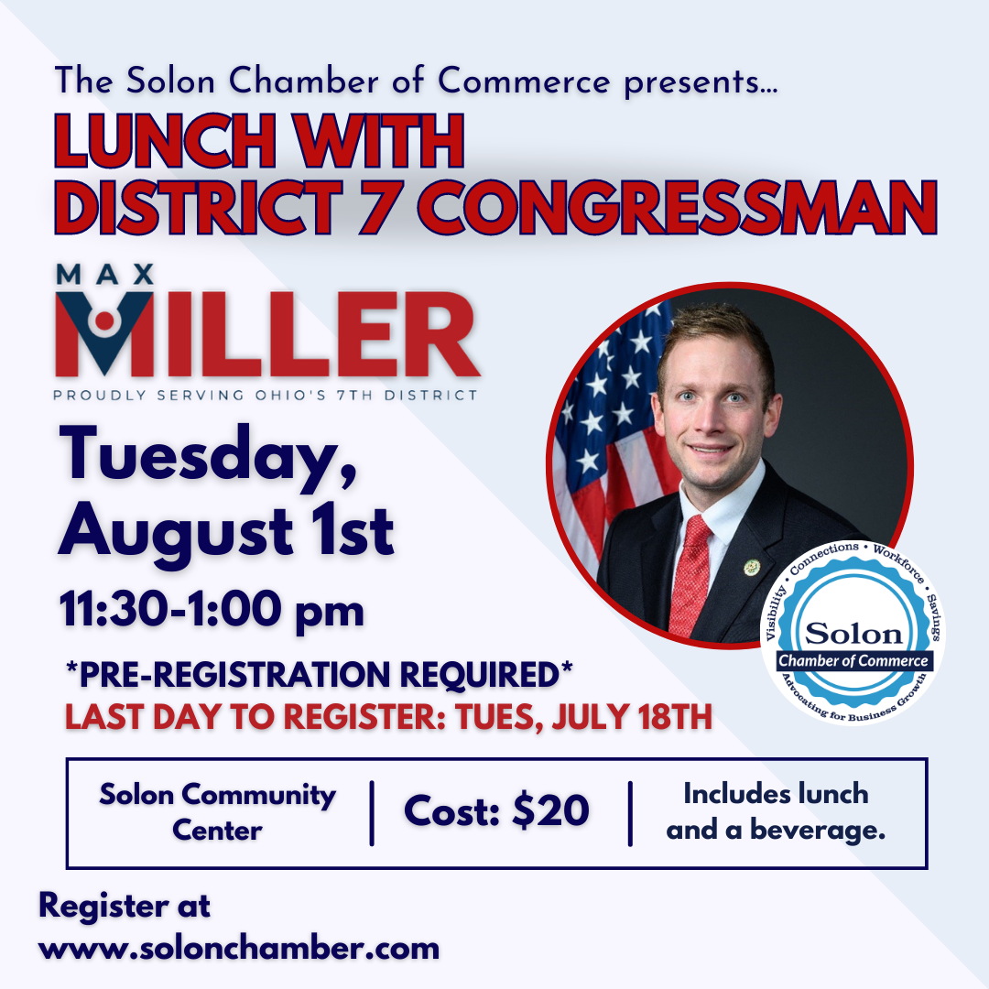

Slide 12
Enroll TODAY at www.solonchamber.com/wrsc

Slide 13
NEW!!!!! BWC Grants Program
1,000 safety grant applications of all types for over $20.5 million were approved!
The Firefighter Exposure to Environmental Elements Grant (FEEEG) will now be on a three-year eligibility cycle with dryers and PPE cleaners now being additional eligible items. Eligible employers will be able to apply for up to $15,000 every three years.
The School Safety and Security Grant (SSSG) will now be on a three-year eligibility cycle. Eligible employers will be able to apply for up to $40,000 every three years.
The Employer working with Person with Developmental Disabilities (EWPDD) grant and Workplace Wellness Grant programs have phased out due to decreasing enrollment.

Slide 14
Private Employers Important Dates
July 1
Payroll true-up period for policy year 2022 begins
Early Payment Discount due date employer must pay the full PY 2023 estimated annual premium
July 31
.99 EM Construction Cap deadline to opt out or submit Safety Management Self-Assessment (SH-26)
Drug-Free Safety Program (DFSP) accident analysis training deadline for 7/1 start date (initial year only). New supervisors have 60 days from hire date to complete
Drug-Free Safety Program (DSFP) online Safety Management Self-Assessment (SH-26) deadline for 7/1 start date
Notes:
Read slide

Slide 15
Public Employers Important Dates
July 31
Deductible Program application deadline for 1/1/2024 start date
Group Retrospective Rating application deadline for 1/1/2024 start date
One Claim Program (OCP) application deadline for 1/1/2024 start date
Retrospective Rating application deadline for 1/1/2024 start date

Slide 16
BWC Monthly Employer Webinars
The July webinar will include:
BWC E-Accounts
Drug-Free Safety Program
Annual employer true-up
Important dates
Monthly safety topic
Next webinar: Tuesday, July 11 1:30 PM
Thursday, July 27 11:30AM

Slide 17
BWC Safety Webinars
Best Practices for Virtual Safety Training July 27th 10:00 a.m.–11:30 a.m.
Introduction to workplace noise
evaluation and control Aug 1st 11:00 a.m.-12:00 p.m.
Accident inv: Ergonomic injuries Aug 15th 12:00 p.m.-1:00 p.m.

Slide 18
BWC DSH Virtual Training
Safety Series Workshop Module 1:
Intro to OSHA Requirements and
Safety Culture Basics (VTC) Aug 15th 9:30 a.m.-1:00 p.m.

Slide 19
Eliminating Waste & Improving Health & Safety Outcomes

Slide 20
Agenda
Who is BowTie?
Why is this relevant to Safety?
What can I do to improve the health and safety of my employees?

Slide 21
Why does BowTie exist?
Today’s health care systems are full of waste, as much as 30-50%.
By targeting waste in the system, BowTie creates health plans that improve health and reduce cost.

Slide 22
Who is BowTie Medical?
A Primary Health Care Team that is focused on improving the health of your employees and reducing the overall cost of your health plan.

Slide 23
The Critical Role of Primary Care
Hospital Care
Labs
Diagnostic Testing
Dermatologist
Physical Therapy
Primary Care Doctor
Outpatient Surgery
Gastroenterologist
Orthopedist

Slide 24
Orthopedist
Diagnostic Testing
Hospital Care
Dermatologist
Physical Therapy
Gastroenterologist
Outpatient Surgery
Labs
Primary Care Doctor

Slide 25
Market consolidation reduces competition and drives misaligned incentives that
Hospital Care
Labs
Diagnostic Testing
Dermatologist
Physical Therapy
Outpatient Surgery
Reduces patient face-time
Reduces root cause analysis
Increases testing
Increases in-system referrals
Increases Rx utilization
Gastroenterologist
Orthopedist
Notes:
50%
of healthcare expenses are for hospital services, including both inpatient and outpatient services.
One of the more recent trend we have witnessed in healthcare is the consolidation within large metropolitan areas of hospital systems aggressively acquiring stand alone physician practices. This strategy has furthered the issue with waste in the system as follows:
Hospitals by their nature and overhead tend to provide the most expensive care. Buying up the stand-alone practices reduces competition and raises prices of primary and specialty care. The overhead of hospitals is much greater than that of small, stand-alone facilities and the need to cover the overhead costs drives up patient care expenses.
PCP’s have relationships with patients and end up directing the patient to services exclusively within the hospital system – they become captive clients to the highest cost delivery of care.
Hospital employed Physicians are now measured by revenue generation and the need to satisfy the financial needs of a larger organization is typically much greater than that of a standalone practice

Slide 26
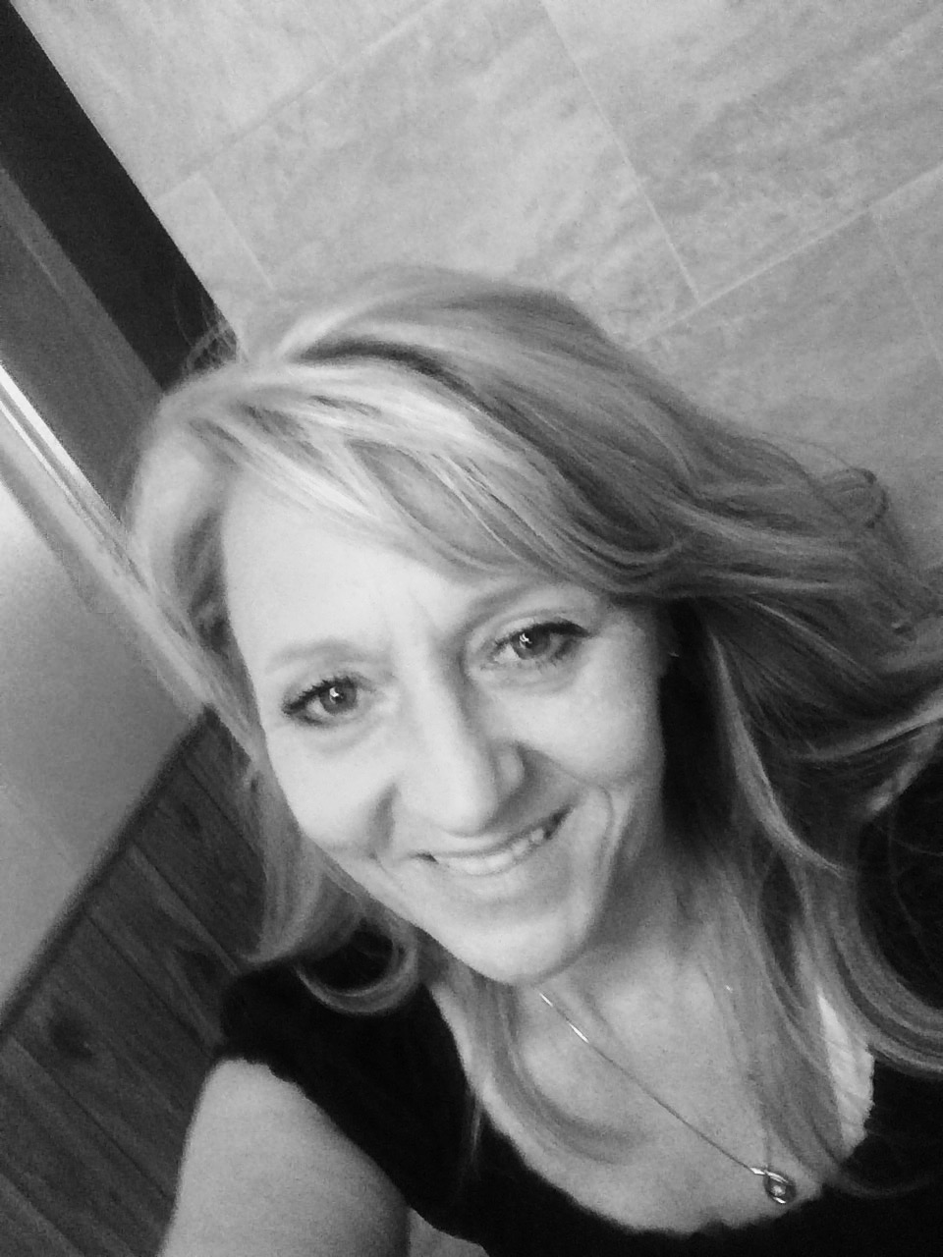
xsxs
Member
Engagement
BowTie At a Glance
QUALITY CARE, CONCIERGE SERVICE, TIMELY & CONVENIENT, FAIR PRICED
24/7 Tele Urgent Care
Healthcare Navigation &
Price Shopping
2nd Opinion Management
BowTie Integrated Care
Common Specialty Care Options
Member
Medical Bill Question Support
Open Access Network of Specialty Care
BTM Virtual Primary Care
BowTie Lead Guardian
Assigned to the Family
Common Mental Health
BTM Health Guardians
Mon – Fri | 8am – 8pm EST
Onsite at Employer
Call – Text Chat
Cost Reduction Strategies
BowTie Lead Physician
Assigned to the Family
Notes:
The guardian is the foundation for success and the director that steers the member toward better decisions. Tools are available today, but few of us use them frequently enough to become proficient. We provide each member with their own subject matter expert to help them navigate the complex and sometime confusing waters of healthcare. It is up to the Guardian led Care Team to:
Break down barriers and access to care by directing members to the BTM virtual care team, be it for physical or mental health, involving the appropriate provider. We won’t force your employees to use our Physicians but we know we have the greatest ability to drive out waste if they do and our goal is to ensure every member has a BowTie PCP
- Leverage 2nd opinions appropriately to ensure we avoid unnecessary tests and care
- Identify specific opportunities, build strategies and attack waste in the system, leading your employees to fair market priced providers
- Simplify navigation through the system
- Communicate the various opportunities available for members to be rewarded for making smart decisions

Slide 27
How is BowTie relevant to Safety?
Employee Health & Safety should not be mutually exclusive!
Leverage a professional health team to align the health and safety goals of the organization
Onsite Guardians can assist in:
OSHA Requirements Hearing, Vision, Respiratory
Safety Issue Awareness

Slide 28
The BowTie Health Report
Assessing the Health of your Company

Slide 29
Sample Company: A Breakdown of Members by Health Risk
Sample Company Data
Claim & Pharmacy Data – Last 7 Years
Match Rate of 97%
170 Total Plan Participants
All Data is De-Identified
Sample Company
Members by the numbers
Low Risk: 121
Medium Risk: 37
High Risk: 12
Source: BowTie Health Report – 10/21/2022

Slide 30
Sample Company: Health Cost Distribution
Key Points
A small number of members are driving the vast majority of total cost.
10 Members = 46.8% of Total Cost
41 Members = 77.6% of Total Cost
Source: BowTie Health Report – 10/21/2022

Slide 31
Sample Company: Top Medical Conditions
Medical
Modifiability
Cost
Modifiability
Lung Transplant
Crohn's Disease/Ulcerative Colitis
Kidney Transplant
Psoriasis/Auto Immune Disease
Obesity
GU Prosthesis
High-Risk Pregnancy
Key Points
A review of the highest cost employees revealed these conditions as the primary contributors to cost.
BowTie ranks these conditions by their degree of modifiability.
Color Key
Modifiable Condition
Partially Modifiable
Difficult to Modify
Source: BowTie Health Report – 10/21/2022

Slide 32
Sample Company: Top Pharmacy Issues
Top Pharmacy Issues
Condition | Year | Code | Type | Name | Cost
Cancer | 2020 | J9312 | Procedure | Rituximab | $90k - $150k
Cancer | 2019 | 00069018921 | Rx | IBRANCE | $50k - $90k
Hormone Condition | 2021 | 00169770821 | Rx | NORDITROPIN FLEXPRO | $50k - $90k
Cancer | 2020 | 00069018921 | Rx | IBRANCE | $50k - $90k
Cystic Fibrosis | 2021 | 51167033101 | Rx | Trikafta | $25k - $50k
Cystic Fibrosis | 2021 | 50242010040 | Rx | PULMOZYME | $25k - $50k
Inflammatory / Autoimmune | 2022 | 00074055402 | Rx | HUMIRA | $25k - $50k
Cystic Fibrosis | 2020 | 50242010040 | Rx | PULMOZYME | $25k - $50k
Inflammatory / Autoimmune | 2021 | 50474071081 | Rx | CIMZIA | $25k - $50k
Skin Condition | 2021 | 00002144511 | Rx | TALTZ | $25k - $50k
Inflammatory / Autoimmune | 2022 | 50474071079 | Rx | CIMZIA | $25k - $50k
Hormone Condition | 2021 | 00052031601 | Rx | FOLLISTIM AQ | $10k - $25k
Cancer | 2021 | 60505290103 | Rx | IMATINIB MESYLATE | $10k - $25k
Inflammation | 2022 | 00024591801 | Rx | DUPIXENT | $10k - $25k
Inflammatory / Autoimmune | 2019 | 00069100101 | Rx | XELJANZ | $10k - $25k
Hormone Condition | 2016 | 00013264681 | Rx | GENOTROPIN | $10k - $25k
Degenerative Bone Disease | 2022 | 00002840001 | Rx | FORTEO | $10k - $25k
Inflammatory / Autoimmune | 2020 | 59572063106 | Rx | OTEZLA | $10k - $25k
BowTie has identified about 1,000 drugs that are the costliest. Members utilizing these drugs are flagged and listed here.
Source: BowTie Health Report – 10/21/2022

Slide 33
Sample Company: Potential High-Cost Conditions (Time Bombs)
Membership Broken Down by High-Cost Conditions
15% of the 80,000 Known Diagnosis Codes Correlate with High-Cost Claims
74% of Your Employees have these Conditions
Sample Company
Members by the numbers
High-Cost Conditions: 125
Healthy: 45
Source: BowTie Health Report – 10/21/2022

Slide 34
Sample Company: Potential High-Cost Conditions (Time Bombs)
Membership Broken Down by High-Cost Conditions
With input from your Safety Team, BowTie can help identify conditions that are relevant to your safety strategy and objectives.
Sample Company
Members by the numbers
High-Cost Conditions: 125
Healthy: 45
Source: BowTie Health Report – 10/21/2022

Slide 35
Summary
Health Plans are moving toward aligned provider involvement
Engaged providers with your Employees & Safety Team, provide the opportunity to enhance safety goals and objectives
BowTie can provide an overview as to how this can work with your company

Slide 36
The Raffle
$100 Amazon Gift Card
Complete the Survey Form on your table
Forms will be collected toward the end of today’s safety presentation
Drawing at the conclusion of the presentation

Slide 37
Thank you.
Rob Winings
rwinings@bowtiemedical.com
216.965.3783

Slide 38
Shawn “Iz” Isbell
iz@motivatewithiz.com
motivatewithiz.com

Slide 40
Shawn “Iz” Isbell
iz@motivatewithiz.com
motivatewithiz.com

Slide 41
Slides, External resources & registration can be found at www.solonchamber.com/slides
Materials will also be distributed by email after the program!

Slide 42
August 9th
Achieving EPA Compliance with Miranda Garritano & Tamara Girard, Ohio EPA
September 13th
Basic Electrical Safety with Andrew Johnson, Sotaris

