Slide 2
Program Sponsor

Slide 3
Slides, External resources & registration can be found at www.solonchamber.com/slides
Materials will also be distributed by email after the program!

Slide 4
April 10th
Stress Management with Mandy McIntyre, Level Up Consultants
May 8th
De-Escalation with Patrick Johnson, PRADCO

Slide 10
Important Dates – state funded Employers
Mar. 29
One Claim Program (OCP) training requirement deadline
Drug-Free Safety Program (DFSP) annual report due
EM Cap safety training requirement deadline

Slide 11
Employer Webinars
OHID for employers
The cost of a claim
Important dates
Monthly safety tip
Dates: March 28 11:30 – 11:55 AM

Slide 12
SAFETY Webinars
How to read a Safety Data Sheet 2-3 pm Mar 5
Why trench safety is important, an analysis of some tragedies that should have been prevented 10-11 am Apr 4
Each individual attending should register in the BWC Learning Center

Slide 13
Virtual Classes
Violence in the workplace (VTC)* March 14
Hazardous waste operations and emergency response series module 8: Confined spaces (VTC)*OSHA recordkeeping half-day workshop March 18
Hazardous waste operations and emergency response series module 9: Site safety plan and contingency planning (VTC)* March 25
Hazard communication half-day workshop (VTC) April 9
Safety Series Module 4: Walking Working Surfaces and Emergency Action Plan Basics (VTC) April 10
Each individual attending should register in the BWC Learning Center

Slide 14
In-Person Classes
Electrical safety in the workplace through
insight and implementation of NFPA 70E – Youngstown April 4
Respirator Fit Testing- Cleveland April 8-9
Each individual attending should register in the BWC Learning Center

Slide 16
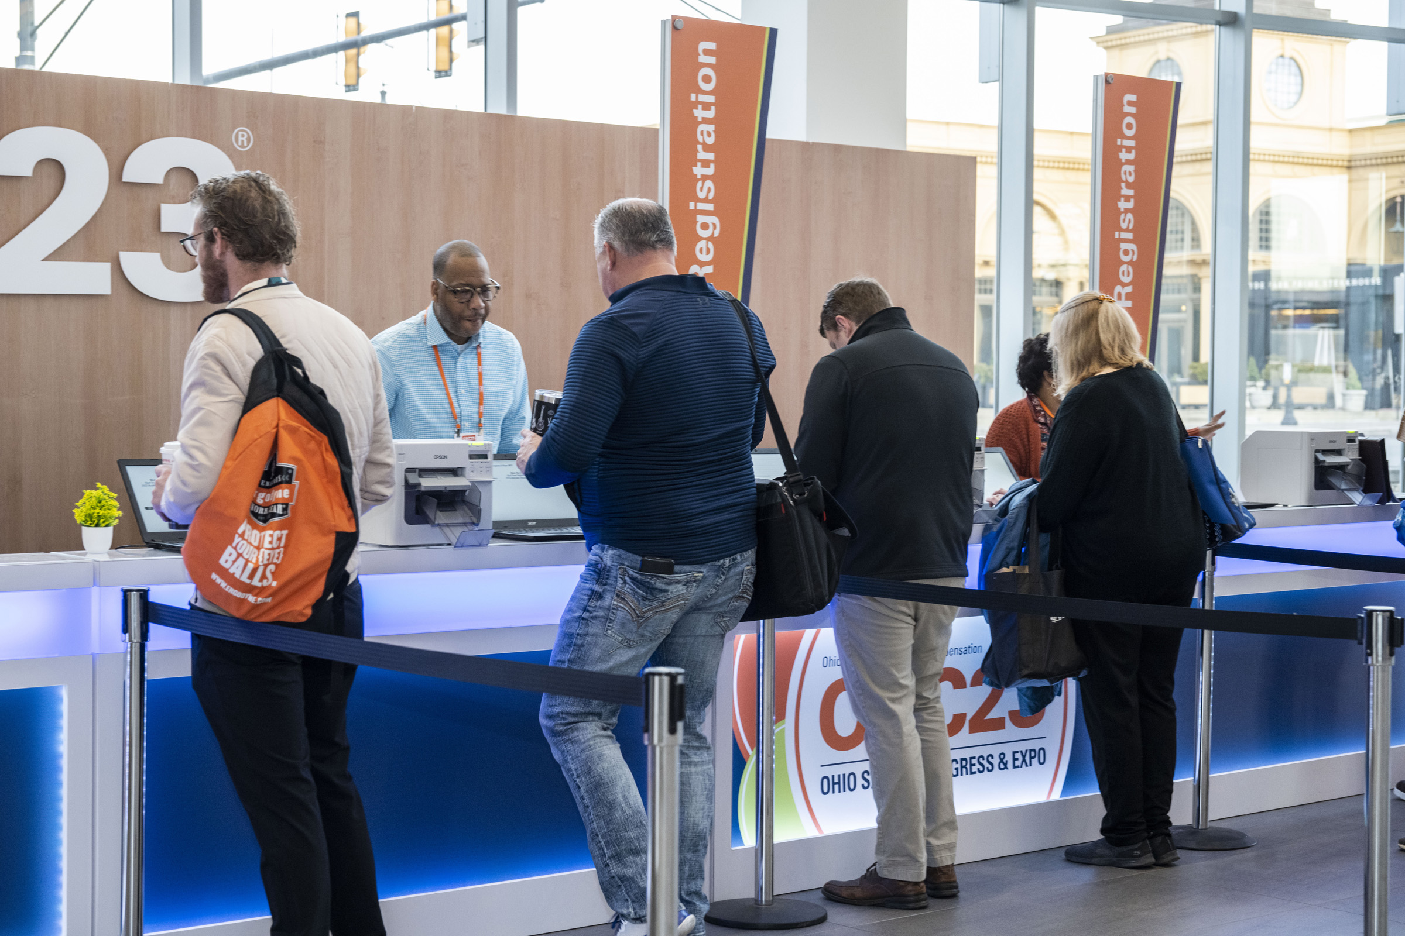
2024 Ohio Safety congress & expo® ^{March 27-29}
Last minute decision makers – register on-site!

Slide 17
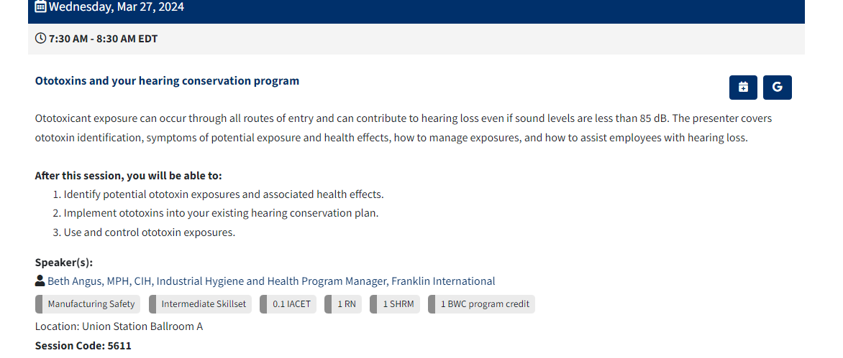
View sessions online to see the credits awarded
Have your badge scanned after each session.
Log on to your online Attendee Service Center and evaluate each session you attend.
Print your certificate of attendance, available for 14 days after the event.
.

Slide 18
Live-streamed sessions
You must register to access the live-streamed sessions during OSC24®.
Once OSC24® kicks-off you can conveniently access live-streamed sessions through your Attendee Service Center.
Live streamed educational sessions do not qualify for CEUs or BWC Discount Program Credits.

Slide 19
Questions?
Contact Us
SafetyCongress@bwc.ohio.gov
Call or text 614-800-5221

Slide 20
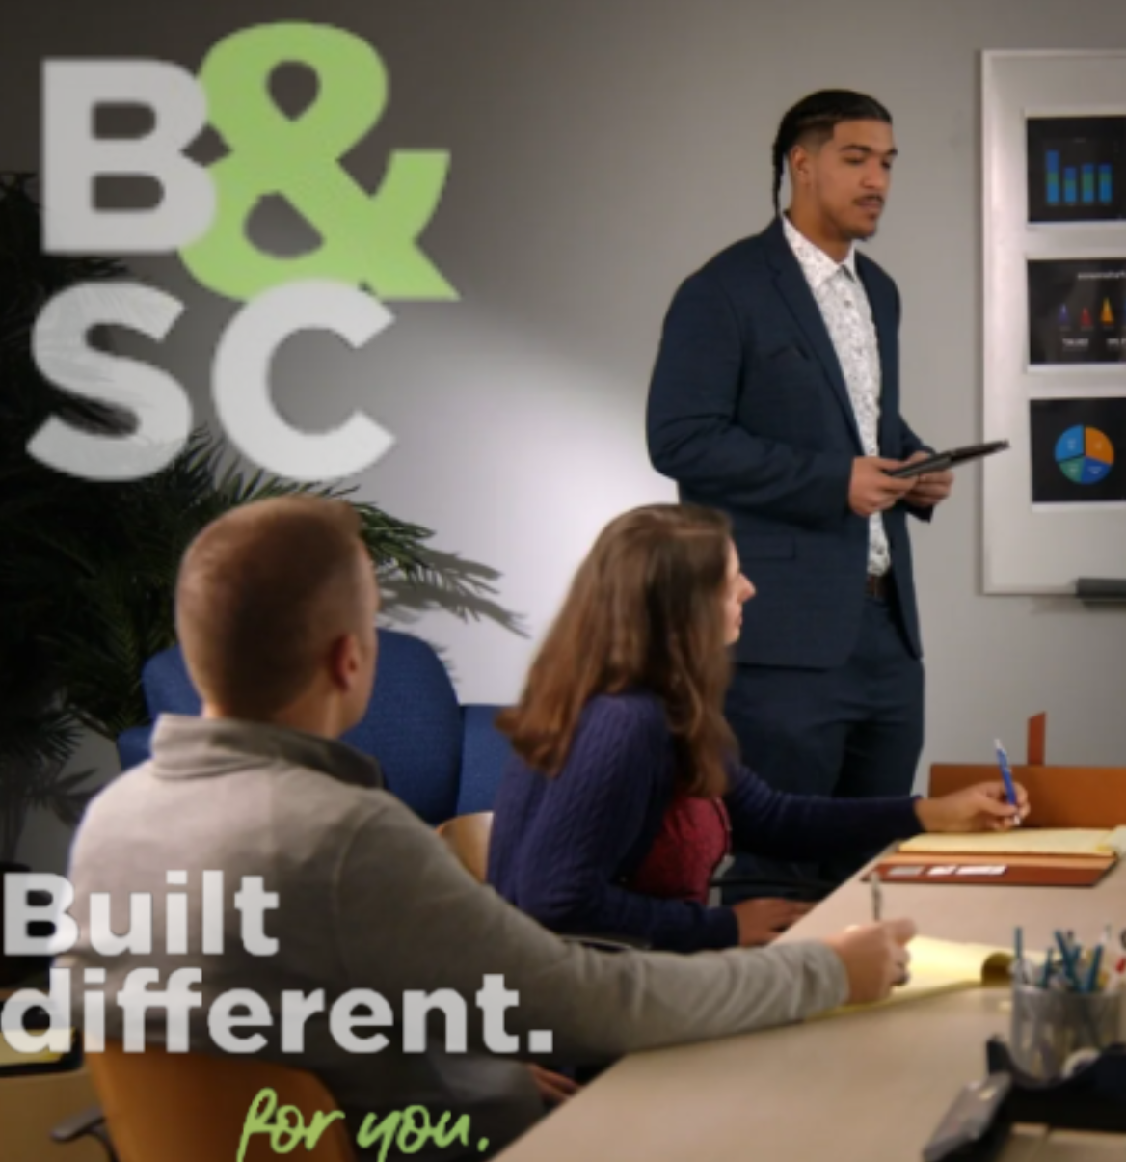
Leadership Expedition Bryant & Stratton college, 2024

Slide 21
A guide to common issues for new managers
Bryant & Stratton college

Slide 22
Many new managers are promoted because they are very good at what they do
These managers may not have experience, education or training in specific management knowledge, skills, or abilities

Slide 23
This training is designed to fill knowledge gaps and help these new managers succeed
The following slides include the specific topics for employers to choose from for training. Employers may choose as many topics as they wish.

Slide 24
topics
Managerial Excellence
Mastering the Do’s and Don’ts
Communication Mastery
Navigating Feedback and Expectations

Slide 25
Topics (Continued)
Mastering Time management
Prioritizing
Delegation
Emotional intelligence

Slide 26
Topics (continued)
HR Legal Essentials
Navigating Employment laws
Policies and procedures

Slide 27
Topics (continued)
Strategic Solutions
Problem Solving
Decision Making
Unleashing Leadership
Motivation Principles

Slide 28
Topics (continued)
Harmony at work
Conflict resolution
Bridging generational differences

Slide 29
Customizable
Choose any topic or number of topics
It is recommended to always start with Unit 1
Unit 1 includes the most common mistakes made by new managers
Each unit can also be customized to include specific employer requests

Slide 30
Time involved
Each unit is designed to take up to 3 hours
This can be shortened or lengthened depending on the employer requests
Multiple units can be done on the same day if time permits

Slide 31
Training procedure
Each unit will include training, discussion and practice activities
Practice activities can also be customized
On site training will require a projector for sharing PowerPoints if possible

Slide 32
We look forward to meeting your training needs for new managers
Thank you for your time

Slide 34
BWC Basics
How’d Ohio end up with a Monopolistic System, and how does it work anyway?
Presenter: Christine Williams, Regional Business Consultant

Slide 35
History of Workers’ Comp in the U.S.
Before workers’ compensation:
Negligence liability - Workers had to show that their injury was the result of the employer’s negligence.
Many disabled workers received no compensation for legitimate injuries
Basically, an injured worker would have to sue their employer for benefits.
An injured worker’s successful lawsuit could financially devastate the employer

Slide 36
History of Workers’ Comp in the U.S.
Before workers’ compensation :
Employer could use three defenses
Worker assumption of risk
Injury was caused partly by the worker’s own negligence
Injury was caused by a co-worker

Slide 37
History of Workers’ Comp in the U.S.
Before workers’ compensation:
Many disabled workers received no compensation for legitimate injuries
An injured worker’s successful lawsuit could financially devastate the employer

Slide 38
History of Workers’ Comp in the U.S.
1911 – Mandatory, comprehensive workers’ compensation was first legislated in Wisconsin and 9 other states
1912 through 1948 – All states enacted laws addressing workers’ compensation coverage
Ohio’s workers’ compensation coverage began in 1912 as a monopolistic system outlined in the Ohio Revised Code

Slide 39
The Ohio Workers’ Compensation Act
Injuries are compensable when all of the following are present
Employer/employee relationship
Physical injury
Arising out of/in course of employment
Ohio jurisdiction

Slide 40
Hearing Process
Receipt of claim by Administrator
Customer Service Team
14 day appeal
District Hearing Officer (DHO)
14 day appeal
Staff Hearing Officer (SHO)
14 day appeal
Industrial Commission Level (ICL)
60 day appeal
Judicial system
Court of Common Pleas
Notes:
The 14 day appeal period does not apply to a BWC C-92 Tentative Order. The appeal period for this order is 20 days from issuance to appeal to the DHO and 10 days for the DHO order to appeal to the SHO. There is no further appeal on a C-92 issue.

Slide 41
Rate Making
BWC is a single lines insurance carrier, providing workers’ compensation to over 250,000 private employers and 3,900 public employers
Like all insurance companies, BWC must establish base rates and determine what an employer must pay in premium to cover claims filed
Each year, BWC must collect enough premium to pay the ultimate costs of claims occurring in that year.

Slide 42
Determining an Employer’s Share of the Premium
Once BWC determines how much premium will be collected, we determine how we will distribute that premium amongst all Ohio state-fund employers.
The intent is to collect a premium from each employer that reflects the risk each employer brings to the state insurance fund.

Slide 43
Experience Rating
Employers are incentivized to maintain safe workplaces and implement good claims-management practices by the rate making process
Employers with more than $ 2,000 in expected claims costs are rated based on their individual past experiences.
Employers with less claims costs than expected pay less than the base rate.
Employers with more claims costs than expected pay more than the base rate.

Slide 44
BWC Ratemaking
BWC calculates an Experience Modifier (EM), which provides a quick way to tell how an employer’s claims management efforts are going.
EM >1.0 Employer is penalty rated
EM = 1.0 Employer is base rated
EM < 1.0 Employer is credit rated

Slide 45
Calculating the Experience Modifier (EM)
The formula compares an employer’s actual claims costs to its expected claims costs.
An employer should be aware of this comparison and use it as the basis of their claims management strategies.
Desired: Actual claims costs< than expected

Slide 46
Workers’ Compensation Claims Management
How is claims management defined in Ohio?
The management process for ensuring timely filing of claims, care for injured workers and minimizing the financial impact of claims on the organization
Simply put, effective claims management means minimizing claims costs
How can an employer do it?

Slide 47
Cost-Control Strategies
Wage Continuation
Return to Work
Claim settlement
Handicap reimbursement
Subrogation – HB 207- 100% of claims costs paid out of the surplus fund, no impact on experience.

