Slide 2
Program Sponsor

Slide 3
Slides, External resources & registration can be found at www.solonchamber.com/slides
Materials will also be distributed by email after the program!

Slide 4
November 8th
OSHA Recordkeeping with Scott Turner, Ohio OSHA
December 13th
Sustainability with Adriana Townsend, August Mack Environmental

Slide 9
Important Dates – Private Employers
Nov. 20
Group experience rating application deadline for 7/1/2024 start date

Slide 10
Important Dates – Public Employers
Nov. 15
Deadline for deferred payment option for PY 2024
Last date employer can change installment plan for PY 2024
Nov. 30
Drug-Free Safety Program (DFSP) application deadline for 1/1/2024 start date
Transitional Work Bonus application deadline for 1/1/2024 start date

Slide 11
Employer Webinars
Cost Control Strategies
Important dates
Monthly safety tip
Thursday, Oct. 26, 11:30 AM
Past webinars are recorded and available
(put “webinar” in BWC website search box)

Slide 12
Safety Webinars
Overlooked hazards in industrial hygiene Oct 24 11 a.m.-12 p.m.
Each individual attending should register in the BWC Learning Center

Slide 13
Virtual Classes
Improving hazard recognition through visual literacy Oct 25-26
Hazardous Waste Operations and Emergency Response
Series- Module1: Regulatory background (EPA, DOT, OSHA) Oct. 30
Job Safety Analysis Nov 1
Crisis de-escalation tactics and safe work practices workshop Nov 8
Each individual attending should register in the BWC Learning Center

Slide 14
In-Person Classes
First aid in the Workplace October 17 Youngstown
First aid in the Workplace October 24 Canton
First aid in the Workplace October 31 Mansfield
OSHA 30: Construction Nov 6-10 Cleveland
Each individual attending should register in the BWC Learning Center

Slide 15
Written Safety Program Templates
Accident Analysis, Bloodborne Pathogens, Confined Space, Driver Safety, Emergency Action Plan, Ergonomic Safe Patient Handling
Fall Prevention (General Industry and Construction), First Aid, Fire Prevention, Fire Extinguisher Program
Hazcom, Hearing Conservation Program, Heat Stress Program
Lockout / Tag out, PPE, Powered Industrial Truck, Respiratory Protection
Violence in the Workplace, Welding

Slide 16
Grants Program
Funding opportunities are once again available for our special safety grant programs.
Trench Safety Grant* for Ohio employers that perform trenching and excavating.
Firefighter Exposure to Environmental Elements Grant combats firefighter cancer risk.
School Safety and Security Grant provides assistance to Ohio employers with ensuring the safety of their staff who instruct children throughout the state.
Safety Intervention Grant assists to purchase equipment to substantially reduce or eliminate injuries and illnesses associated with a particular task or operation.
*One time grant, all others renewable after 3 years.

Slide 17
BWC awards $5 million in grants for workforce safety innovation projects
Grants between universities and Ohio based industries focusing on personal protective equipment (PPE) and personal protective technology (PPT) innovations. The purpose is to safeguard the health and well-being of Ohio’s workforce with their individual projects. Examples of the research includes:
University of Cincinnati
A prototype for the integration of Carbon Nanotube Hybrid Active Textile systems in PPE for Ohio’s firefighters
Development of the Exposure-Protection Integrated Communicator (EPIC) to offer real-time insights into a worker’s proximity environment, personal inhalation exposure levels, and the protective capabilities of their PPE.
Kent State University
Development of zero-power, easily customizable, and wearable toxic gas and vapor sensors to address the critical need for real-time monitoring of toxic gases and vapors, ensuring the safety and well-being of first responders

Slide 18
Brian Chambers Bureau of workers compensation brian.c.1@bwc.state.oh.us

Slide 19
Program Sponsor
Dr. William (Bill) Cunion
Dean of Academic Affairs, Cuyahoga Community College – Eastern Campus
www.tri-c.edu

Slide 20
Workplace Safety
Brian DiRocco

Slide 21
Bio
In the fire service for 25 years (Solon since 2000)
Lieutenant
Paramedic
Fire Safety Inspector
Fire Instructor
CPR Instructor
Stop the Bleed Instructor
Public Education Coordinator
Public Information Officer

Slide 22
Todays topics
Workplace fire safety
Emergency response, fire drills, fire extinguisher training, common fire hazards in the workplace
Safety of personnel
CPR/AED training, first aid training, stop the bleed training
Fire Department Visits
Annual fire inspections, FD walkthrough's

Slide 23
Workplace Fire Safety
Avoid fires to begin with
Keep workplace free of clutter and rubbish
Keep flammables stored properly
Avoid the use of extension (as permanent wiring)
Avoid the use of space heaters
Have designated smoking areas if your company permits
Be careful with cooking devices (gas grills, turkey fryers), if allowed to use keep at a safe distance from building

Slide 24
Fire department visits
Fire safety inspections
Annual walkthrough to educate and help keep the building safe
Fire department walkthroughs
Helps firefighters become familiar with each building and their potential
hazards before an emergency

Slide 25
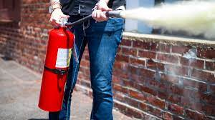
Fire extinguishers
Learn how to use them
Big fires start small

Slide 26
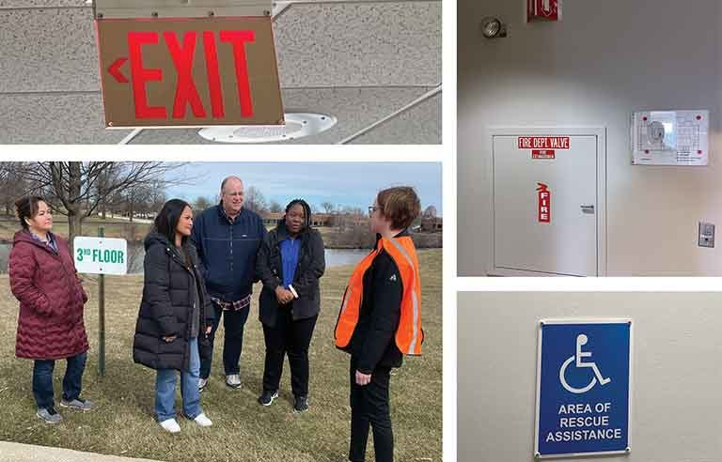
Fire Drills
Important to conduct at least 1 time per year
Establish a meeting place to assemble
Assign members as accountability officers
Practice drills as if this was a real fire event

Slide 27
If there is a fire
Notify the FD, use a pull station and/or call 911
Attempt to use a fire extinguisher (small fires only)
Get out of the building and stay out
Don’t run, remain calm
Don’t waste time gathering belongings, small fires grow fast
Close doors as you leave (this can help contain the fire)
Assist those with special needs (also good to practice during a drill

Slide 28
Things to tell the FD
Is everyone out of the building
If someone is unaccounted for, where should they be
Location of the fire
Severity of the fire
Hazards that we should know about
Building expert, stay with FD if possible during the emergency

Slide 29
Emergency response (SFD)
EMS call, response of 1 ambulance with 2 paramedics and 1 fire engine with 2 paramedics (4 total personnel)
Fire alarm, 2 station response with 1 ladder truck, 1 fire engine, 2 ambulances, and 1 battalion chief (9 total personnel)
Confirmed fire, 3 station response with 1 ladder truck, 2 engines, 3 ambulances, 1 battalion chief, 1 Chief (14 total personnel)
Plus 2 additional engines and 1 additional ladder (12 more personnel)

Slide 30
Emergency command
Command post will be set up at a large event including a fire, spill, leak, mass casualty
Incident Commander will usually (but not always), be in a stationary position. Most likely near the Command Vehicle

Slide 31
Trainings available from the FD
CPR/AED, 3 hour class
First aid, 6 hour class that includes CPR/AED instruction
Stop the Bleed, 1 hour class, hands on training with tourniquet use
Fire extinguisher class, less than an hour (depending on number of employees)

Slide 32
Contact information
Brian DiRocco
bdirocco@solonohio.org

Slide 33
Slides, External resources & registration can be found at www.solonchamber.com/slides
Materials will also be distributed by email after the program!

Slide 34
November 8th
OSHA Recordkeeping with Scott Turner, Ohio OSHA
December 13th
Sustainability with Adriana Townsend, August Mack Environmental

